Slide 1
Danielle R. Snowflack, Ph.D.
www.edvotek.com
Notes:
Hi everyone, and welcome to today’s biotechnology live stream! My name is Danielle Snowflack, and I am the Senior Director of Education at Edvotek. We’re so happy to bring this biotechnology training workshop to you in the comfort of your own home. I know you think of us as the PCR and electrophoresis company, because those are popular experiments that we do really well, but we have many different biotech experiments, and I’m going to run through one with you today.

Slide 2
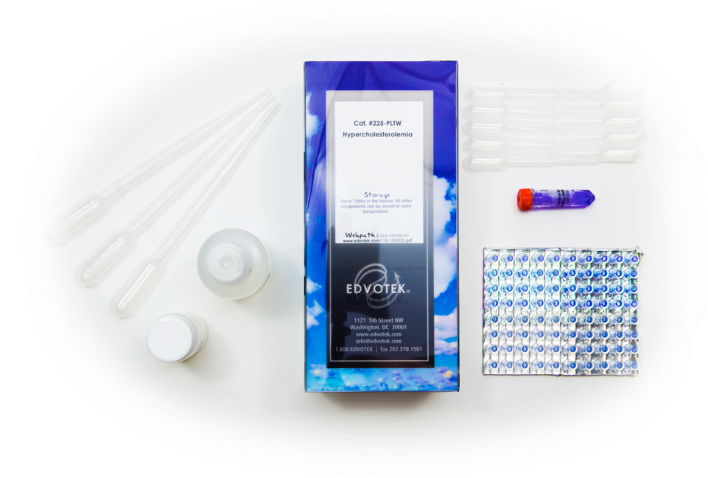
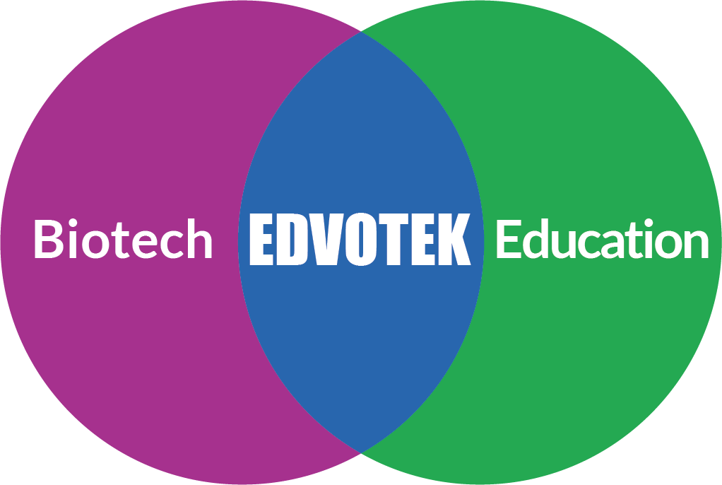
EDVOTEK The Biotechnology Education Company
Celebrating OVER 30 years
of science education!
Notes:
For those of you who are unfamiliar with Edvotek, we are the Biotechnology education company! We were founded over 30 years ago now by Dr. Jack Chirikjian, a professor of biochemistry at Georgetown University. Now, this was an exciting time in the biotechnology lab – think about it, DNA fingerprinting, the development of PCR, genetic engineering like the production of insulin in bacteria – but little of that was being translated into the classroom. And thus, Edvotek was born. Our focus is solely on the education sphere, where we work with educators all over the world to demystify science and foster the next generation of scientists through hands-on, active learning activities.

Slide 3
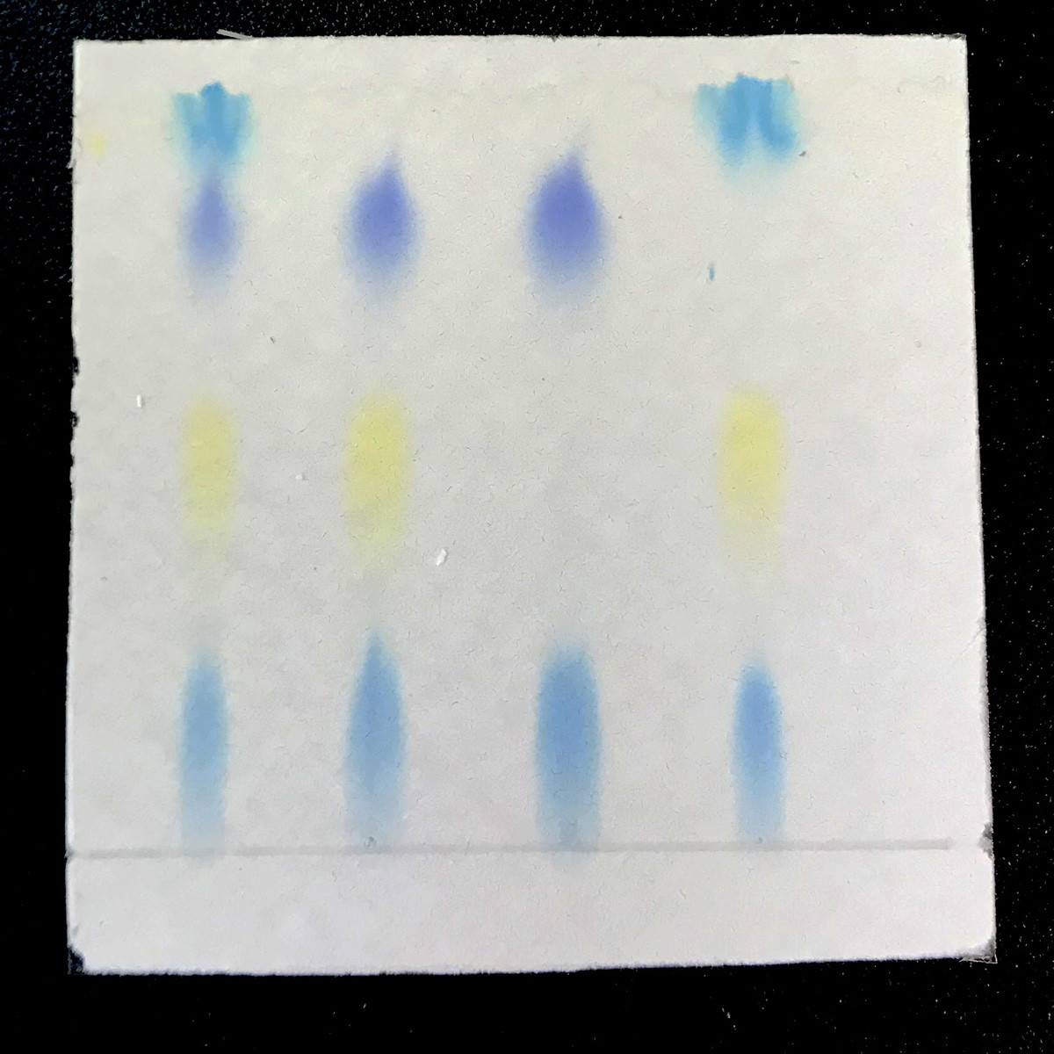
Today’s Experiment: Using Chromatography to Examine Vaping
Chromatography techniques separate molecules based on their physical properties
Today’s Experiment: Edvotek Kit #211
This experiment separates colorful dyes based on their charge.
Great way to bring STEM and public health into the classroom
Notes:
Today, we’re going to focus on chromatography, which is the separation of molecules based on their physical properties. This is an important process for many types of industrial research and development, including biomedical and pharmaceutical research, which we will discuss in this workshop.
The experiment we’re running today is Edvotek Kit 211, which focuses on analyzing simulated vaping products using thin layer chromatography. In choosing this chromatography experiment, we are choosing an experiment that is a natural mix of STEM concepts. This experiment separates brightly colored dyes based on their physical properties. A mathematics extension activity involves measuring the absorbance of the dyes to calculate the dye concentration of each fraction. Using this information, we identify specific molecules in a complex mixture. While this technique is very powerful, it is also easy enough to do in the classroom laboratory – or even in your home, like I’m doing today.
This demonstration will be recorded, and our slides will be available on our website. If you’d like to be notified when they’re posted, please fill the form – the link will be in the chat box. We are also offering professional development certificates to those who watch live! If you would like us to send you a certificate, please be sure to check the box. This link will only be live for one hour after the presentation, so be sure to complete it before 5 PM Eastern Daylight Time.

Slide 4
Everything E – the 101 on vaping
E-cigarettes heat the e-liquid to create a smoke-like aerosol that is inhaled
Around 100 chemical components are present in e-liquids, including flavorings, nicotine, and other drugs
Popularity is growing in many demographics
Long term health consequences still not known
Notes:
Smoking kills. The connection between smoking cigarettes and life-threatening conditions like heart disease, stroke, and lung cancer are clear and well known. But what about e-cigarettes and vaping? Here the messages are mixed. Sometimes e-cigarettes are presented as a safer alternative to more traditional tobacco products. Other times vaping is described as an alarming and dangerous new trend that’s creating the next generation of nicotine users and causing lasting damage to people’s lungs and bodies. So, let’s talk more about what vaping is, what chemicals are involved, and how researchers can evaluate the effects of vaping in the short and long term.
E-cigarettes come in countless shapes and sizes and go by many names including vapes, tanks, and ENDS ( or electronic nicotine delivery systems). Despite their differences in appearances, all these devices have the
same basic construction - a chamber to hold liquid, a heating element such as a coil, a battery, a microprocessor, and a mouthpiece.
Together, these parts heat solutions called e-liquids to the point where it creates a smoke-like mist. While we think of this as a vapor, is more accurately an aerosol, or a suspension of solid or liquid particles in a gas. Many users breathe in this aerosol in order to deliver a potent dose of nicotine. Other users choose to consume nicotine-free e-liquids for the flavors, or to purchase or make black-market e-liquids that can contain additional drugs.
When chemical analysis is performed, around 100 chemical components are present in e-liquids, including flavorings, nicotine, and other drugs. Several of these substances are capable of causing cancer in living tissue and are categorized as carcinogens. Others are classified as irritants because they cause inflammation in our bodies or as poisons because they cause injury and death at high doses.
The popularity of vaping is growing in many demographics. In recent years, the popularity of vaping has grown exponentially. Originally, vaping was promoted as a way for tobacco consumers to quit smoking. However today, many vapers have never used anything but ENDS and e-liquids. While vaping is considered less harmful than smoking cigarettes it is still not considered safe to use or to inhale second-hand.
Unfortunately, there are huge gaps in what we currently know about the safety and long-term health effects of vaping.

Slide 5
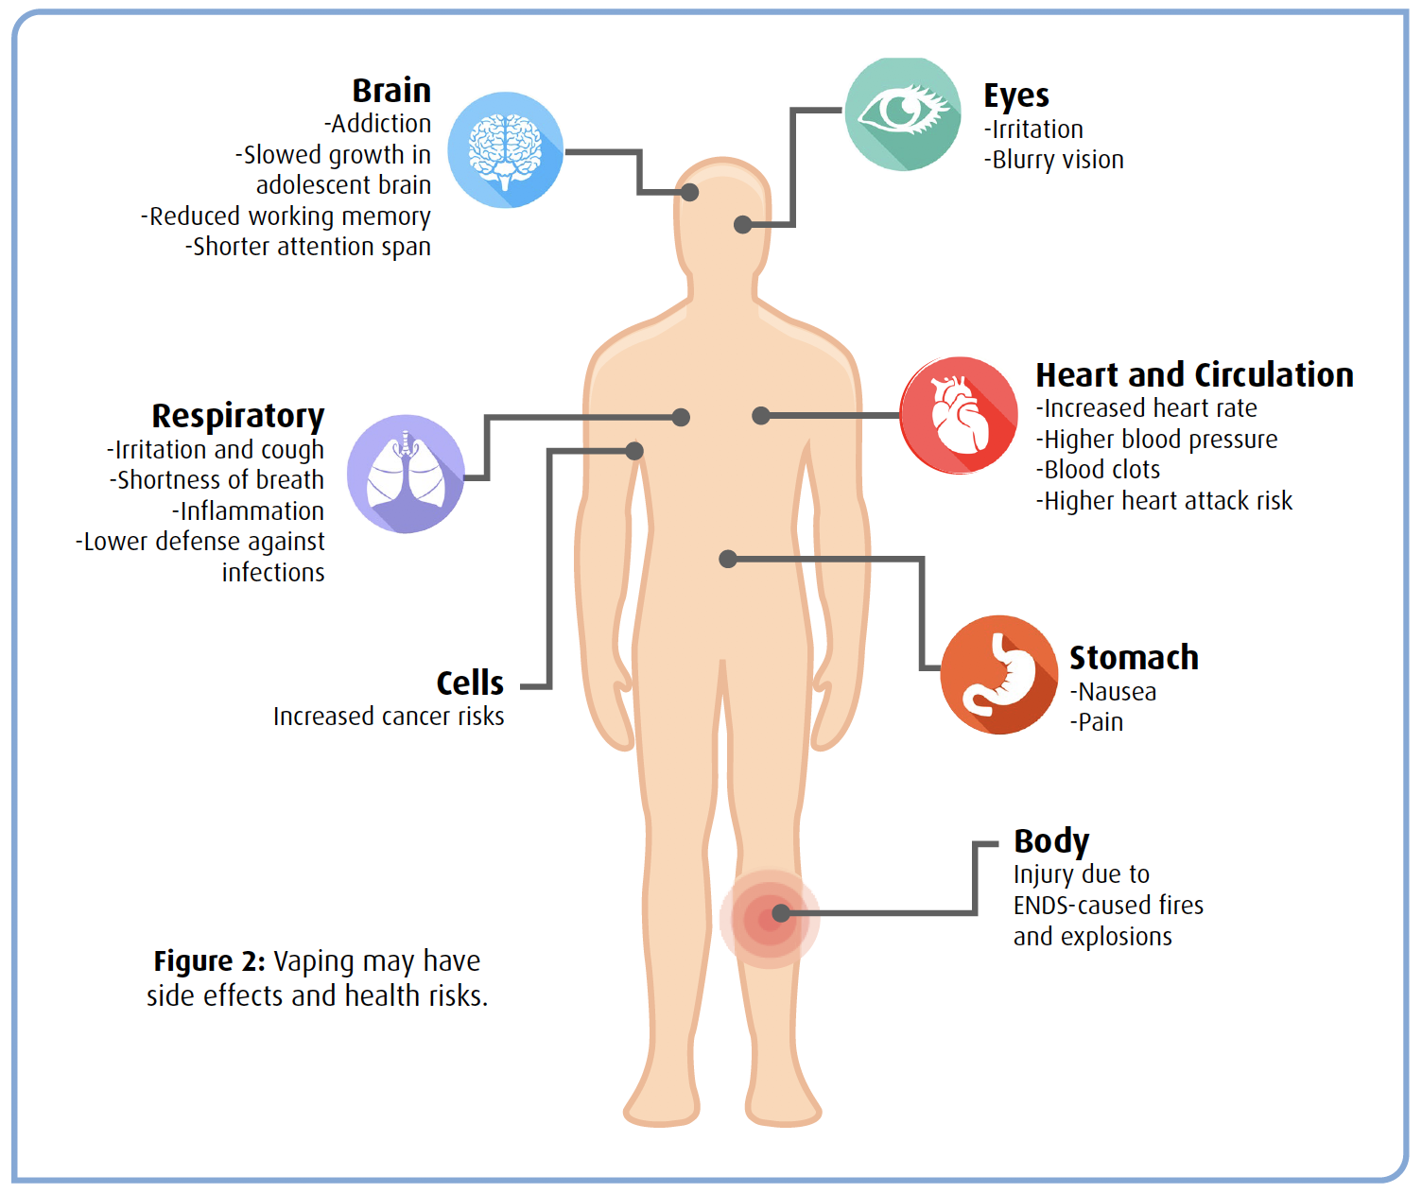
The risks of vaping
Nicotine and other compounds in e-liquids can be addictive
E-liquids can contain chemical ingredients that are hazardous when inhaled
Some health effects may not be obvious in initial studies; chronic conditions only obvious after years
The composition of e-liquids can be analyzed using thin layer chromatography
Notes:
Several health risks are beginning to emerge as vaping becomes more common, and as people are partaking in vaping for extended periods of time. Except for infrequent cases of ENDS units causing dangerous explosions or fires, most health concerns are related to the chemical components of e-liquids. These include solvents like propylene glycol, drugs like nicotine, and contaminants like heavy metals as well as a range of flavors, preservatives, and aromatic transporters.
These additives vary tremendously between different brands and types of e-liquids but most meet food quality standards. However, the high heat of most vaping devices can also cause these chemicals to change or react with one another and create new compounds. Also, the health effects of many chemicals are different when inhaled rather than ingested. Consequently, ingredients that are labeled safe for consumption can still be dangerous when aerosolized and inhaled. A striking example of this happened in the late summer of 2019, when there was an outbreak of severe lung infections in young and otherwise healthy individuals. A common denominator was that all sufferers were vapers. Investigators found vitamin E acetate in the lungs of sick patients but not in healthy individuals. This additive is safely used in nutritional supplements and skin creams. However, when it was added to several black-market e-liquids as a “safe” thickener, it severely damaged the user's lungs and caused them to experience shortness of breath and chest pains. This condition eventually caused thousands of hospitalizations and 55 reported deaths.
There are huge gaps in what we currently know about the safety and long-term health effects of vaping. Researchers are working to narrow these gaps through experiments and clinical tests rather than waiting to observe them in users. Some health effects may not be obvious in initial studies; chronic conditions only obvious after years.
What we do know, from the data that has been available, is that there are a lot of variables when it comes to vaping and the effects on human health. But what we can quickly and easily analyzed are the chemical components within e-liquids, and we can use thin layer chromatography to do that.

Slide 6
History of Chromatography
From the Greek chroma and graphein, which translates to “color writing”
First established in the mid-19th century to separate plant pigments using filter paper.
In the 20th century, the technique expanded to include:
Ion exchange
Size exclusion
Affinity
Thin-layer
Kit 196
Kit 113
Kit 108
Notes:
The word chromatography is from the Greek chroma and graphein, which translates to “color writing.” Fun fact -- the botanist Mikhail Tsvet, who ran the first ‘real’ chromatography experiment, named the technique after himself! His last name in Russian translates to color. So, by using the Greek “chroma”, which also means color, he may have been naming the technique after himself.
The precursors of today’s chromatography can be traced back to the mid-19th century to analyze plant pigments. In these experiments, scientists mixed the pigments with solvents and spotted them onto filter paper. As the pigments traveled through the paper, they separated into distinct pools, creating bands with different colors were produced. <advance>
In the very early 20th century, Tsvet applied the principles of paper separation of plant pigments to column chromatography. Calcium carbonate was packed into a column, and used as the separate the pigments instead of paper. Furthermore, he realized that the solvent used for chromatography was important. Certain molecules would separate better with polar solvents than non-polar, and vice versa.
In the mid-1900’s, the technique expanded to include many different types of separation.
Ion exchange – what we’re doing today, which separates based on molecular charge. <advance>
Size exclusion, also known as gel filtration, which separates molecules based on their apparent size. <advance>
Affinity chromatography, which uses protein binding interactions to separate molecules. <advance>
There’s also Thin-layer chromatography, which binds the matrix to a thin sheet of glass or plastic instead of packing it into a column, which is what we’ll doing today. I’ll abbreviate Thin layer chromatography as TLC throughout the workshop.

Slide 7
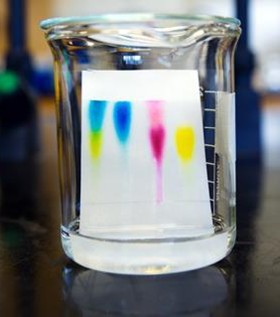
What do I need to perform this experiment?
Thin layer chromatography plate
Solvent systems
Sample Mixture
Pipets
Beakers or glasses
https://edu.rsc.org/science-research/app-quantifies-chemicals-in-thin-layer-chromatography/3010338.article
Notes:
Thin layer chromatography plate – The plate is coated with a matrix, in this case it is Cellulose and it is a polar molecule. The matrix captures molecules that pass through the column based on their chemical properties.
Solvent systems – These are mixtures of buffers and compounds that are used to move the sample mixture through the TLC matrix. They can be polar and nonpolar, which will influence our experiment
Sample Mixtures – in this case, it is a mixture of dyes simulating e-liquids. When we look at the mixture, we see this color. By eye, we couldn’t tell whether this was one molecule that results in this color, or a mixture of two, three, however many dyes that would come together to make this color. We’re going to use the physical differences of these dyes to separate them into pure pools of color.
We need to transfer the samples and buffer. There are a few ways we can do this. One is a plastic transfer pipet. The other is a micropipet, which is a precision tool used to make measurements of very small samples. To simplify today’s demonstration, I’m going to use the transfer pipets. So, we can run this experiment without any special equipment.
And, we’ll perform this in a glass vessel or beaker, in this case jars.

Slide 8
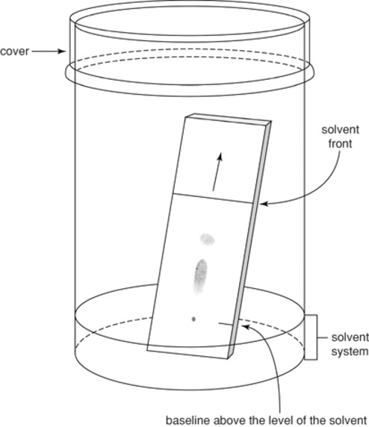
Principles of thin layer chromatography
Chromatography techniques separate molecules based on their physical properties
The stationary phase is the matrix that separates the mixture
The mobile phase comprises the liquid that moves the sample through the stationary phase
Molecules travel through the matrix at different speeds based on their physical properties
https://currentprotocols.onlinelibrary.wiley.com/doi/abs/10.1002/0471142700.nca03ds34
Notes:
Chromatography techniques separate molecules based on their physical properties; in this experiment, it will be whether the molecules are polar or non-polar. In thin layer chromatography, we have the stationary phase plate and mobile phase (buffer).
Here we have our TLC plate, covered with our matrix, which is known as the stationary phase. This matrix is used to physically separate the molecules into different pools. The stationary phase is the mobile phase of the chromatography and flows through the matrix by capillary action. The applied sample is “developed” by our stationary phase. This means that the molecules in the sample are carried by the flow of buffer through the matrix where they are gradually separated. The separated zones of molecules are then visualized to let us identify the chemical components in the mixture.
As the solvent travels up the TLC plate, it’s going to bring the dyes up with it. More soluble dyes travel up the paper with the solvent. Insoluble dyes stay at the bottom of the paper or move slowly. And the solubility is going to depend on the solvent. We’re using two different solvent systems here, so you’ll be able to see that in action.

Slide 9
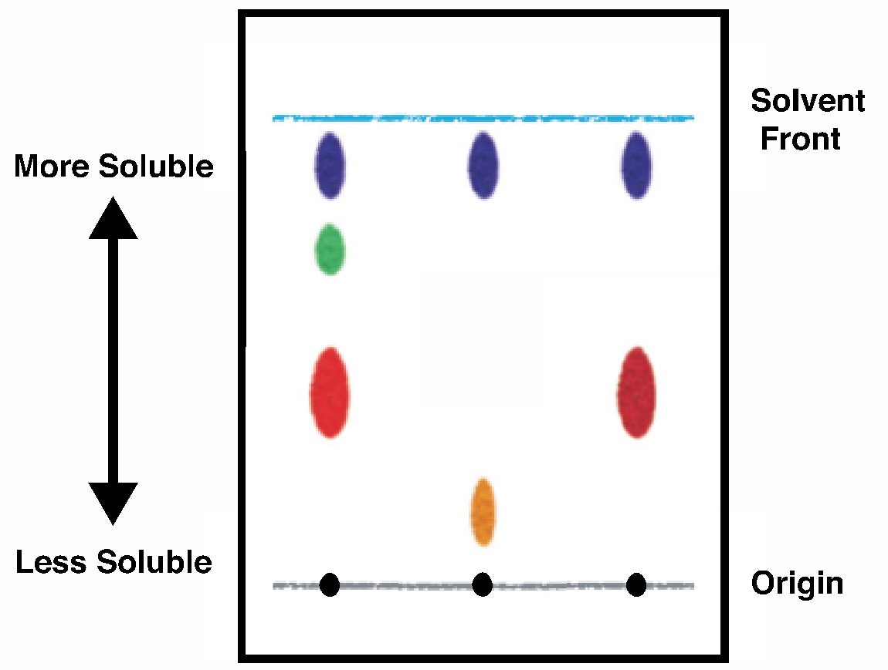
Using chromatography to separate molecules
Spot: The partially or completely separated zones of molecules that are seen on the plate.
Solvent Front: The distance the mobile phase travels through the matrix
Origin: The location where the samples are spotted.
Notes:
So, let’s define some key terms. On the TLC plates, once developed, we have spots: The partially or completely separated zones of molecules that are seen on the plate. Each molecule travels a distance from the origin, or the location where the samples are spotted. The solvent front is the distance the mobile phase travels through the matrix. These values become important for calculations that will let us distinguish between the chemicals present in our simulated e-liquid.

Slide 10
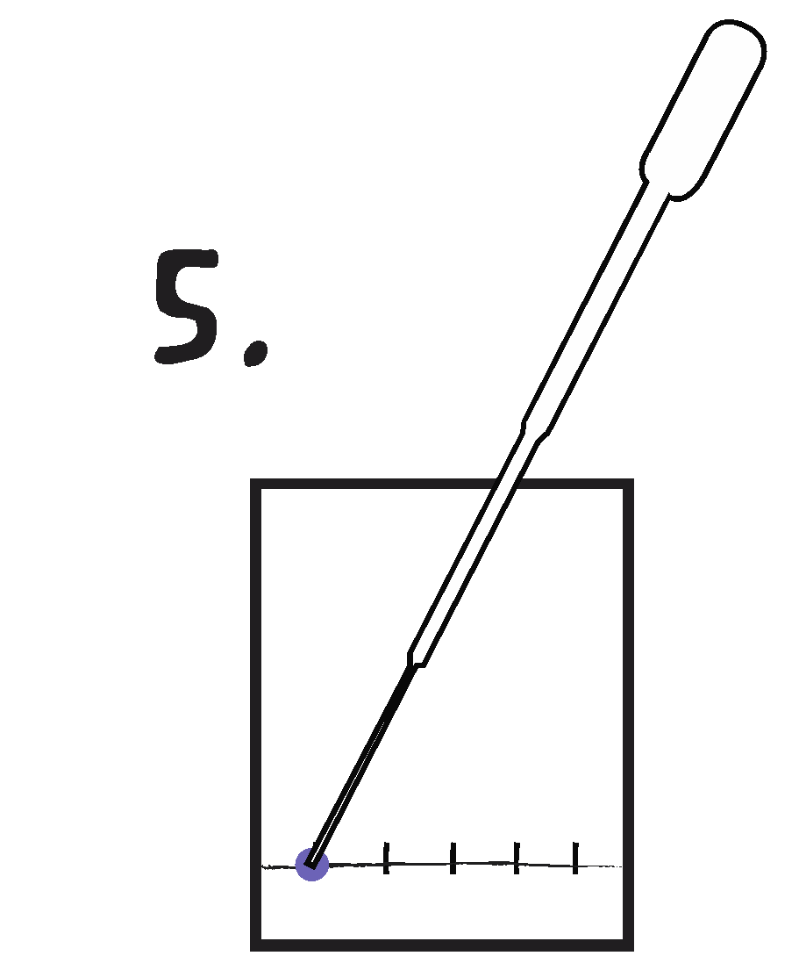
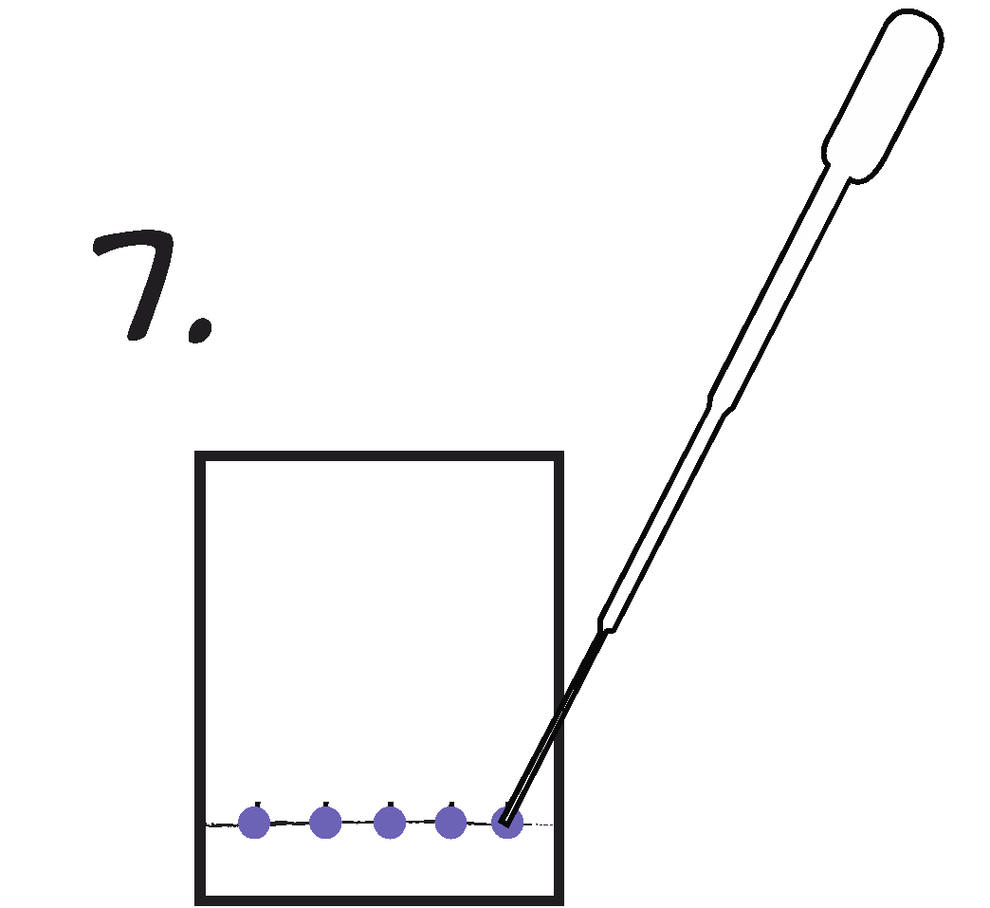
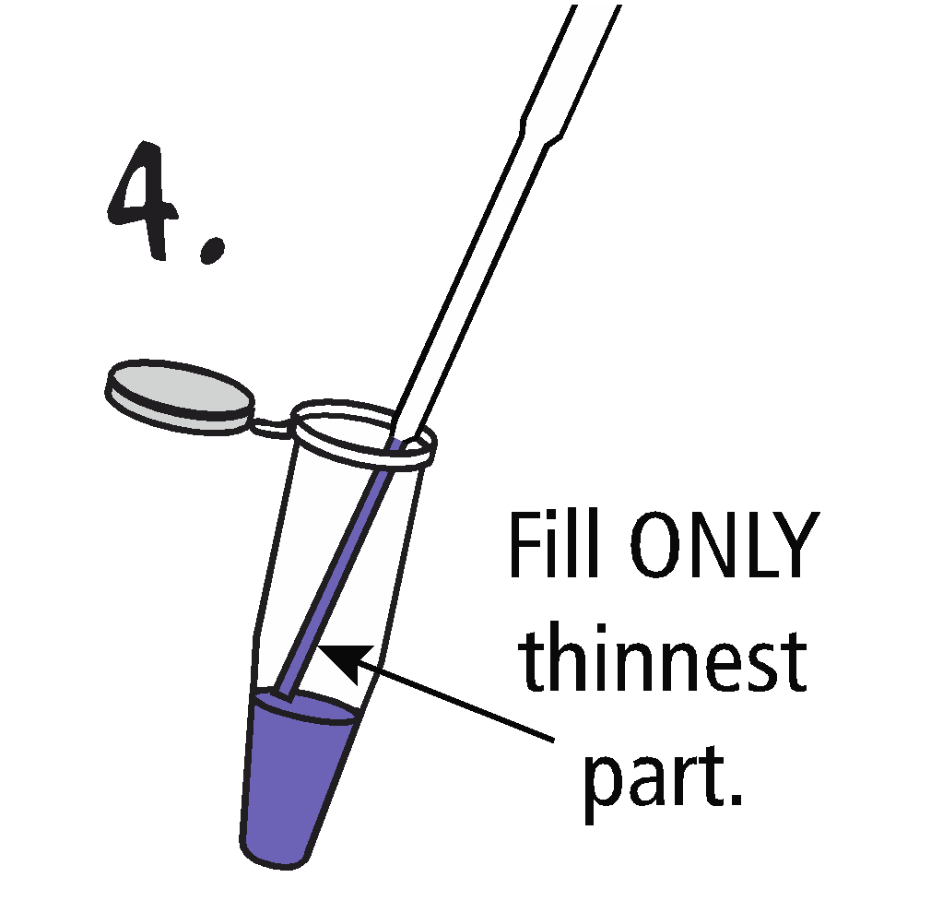
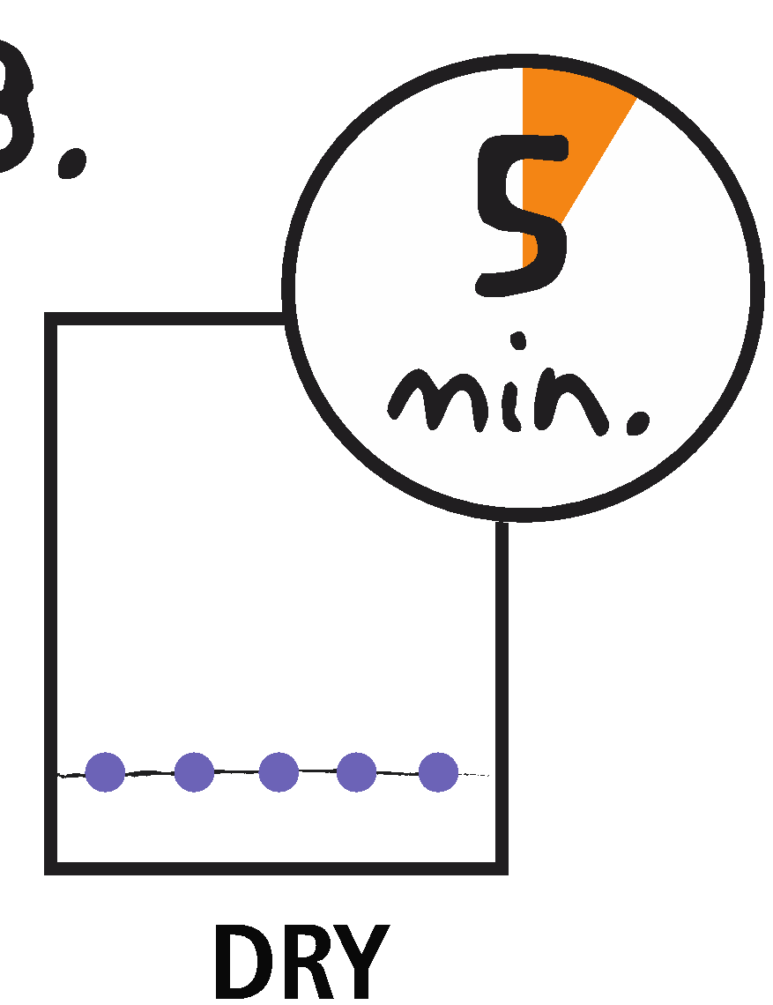
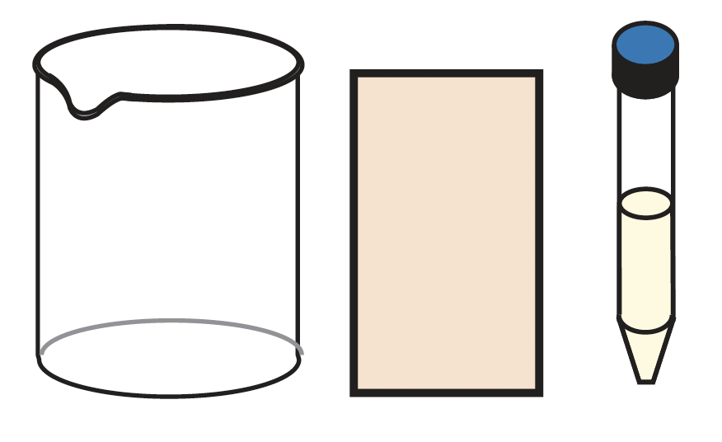
Preparing for thin layer chromatography
1.
2.
3.
4.
5.
Prepare the TLC plate, the solvent, and the samples
Fill the thinnest part of your transfer pipet with vaping solution.
Place the end of the transfer pipet onto the paper. Squeeze and release the bulb. VERY LITTLE sample is needed.
Repeat with additional samples.
Let dry ~5 minutes.
Notes:
So, we’re going to prepare our thin layer chromatography plate. I’ve cut my plate into a rectangle here. I’m going to use a pencil to mark baseline, ink will separate with chromatography, because it is soluble in our solvent. Fill the thinnest part of your transfer pipet with candy color solution. I actually like to squeeze lower than the bulb, gives some more control. Then place the end of the transfer pipet onto the paper. Squeeze and release the bulb. VERY LITTLE sample is needed. Rinse the pipet with clean water and repeat with additional color samples. We’re going to let this dry while I’m loading our electrophoresis gel.

Slide 11
A molecule’s bonds determine its polarity
Polar bonds: atoms share electrons equally.
One part of the molecule is more positive and one part is more negative, creating poles
Hydrophilic - “water-loving”
Nonpolar bonds: atoms do not share electrons equally.
No part of the molecule has a charge, so there are no poles
Hydrophobic – “water-fearing”
Notes:
Thin-layer chromatography is particularly sensitive to small differences in the structure and polarity of different chemicals. Structural features include molecular weights, geometry, and carbon-carbon double bonds. These physical traits influence how easily a molecule migrates through the stationary phase. Polarity describes molecules that have sub-areas of positive and negative charge. This occurs when one nucleus in a molecule attracts the negatively charged electron more strongly than the other nuclei. <advance>
In polar bonds: atoms share electrons equally. One part of the molecule is more positive and one part is more negative, creating poles. We call these hydrophilic molecules, or “water-loving”
In contrast, nonpolar bonds: atoms do not share electrons equally. No part of the molecule has a charge, so there are no poles. And we call these Hydrophobic – “water-fearing”

Slide 12
Thin layer chromatography separates molecules by physical properties
The plate is coated with an adsorbent material
The mixture is spotted onto the plate and placed in a beaker containing solvent
The solvent moves the mixture through the matrix
More polar molecules ‘stick’ to the matrix more than nonpolar molecules
Notes:
The plate is coated with an adsorbent material, in our case cellulose. The polarity of this molecule directly infulences our results because the molecules bind differently to the matrix based on their properties. The stationary phases used in TLC experiments are usually a mixture of neutral molecules, polar molecules, and even more strongly charged ionic compounds. These molecules interact with polar molecules in a sample and slow their rate of migration. The matrix spread on our TLC plate is cellulose.
The e-liquid mixture is spotted onto the plate at the origin. Then, we place it in the solvent to move the samples through our adsorbent matrix. More polar molecules ‘stick’ to the matrix more than nonpolar molecules. The nature of this solvent influences the mixture through the matrix, which we’ll talk about shortly

Slide 13
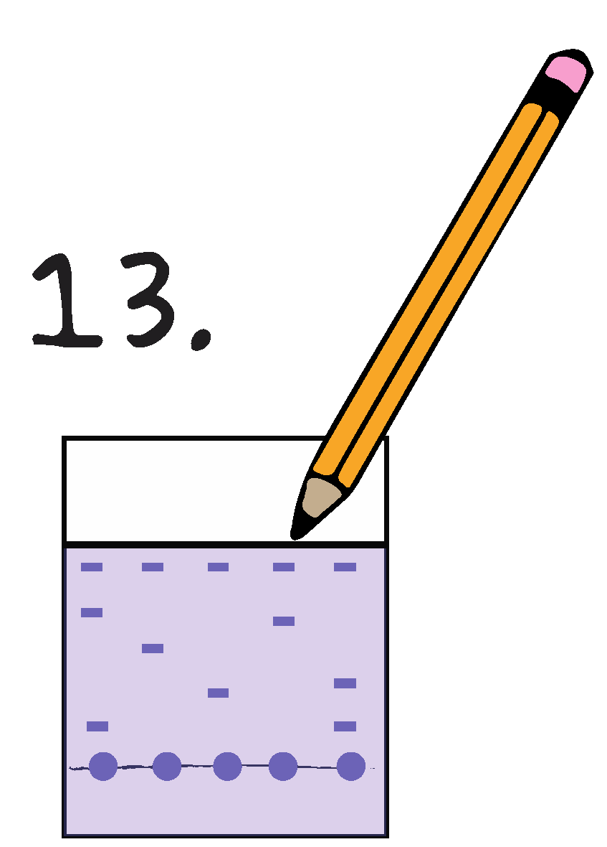
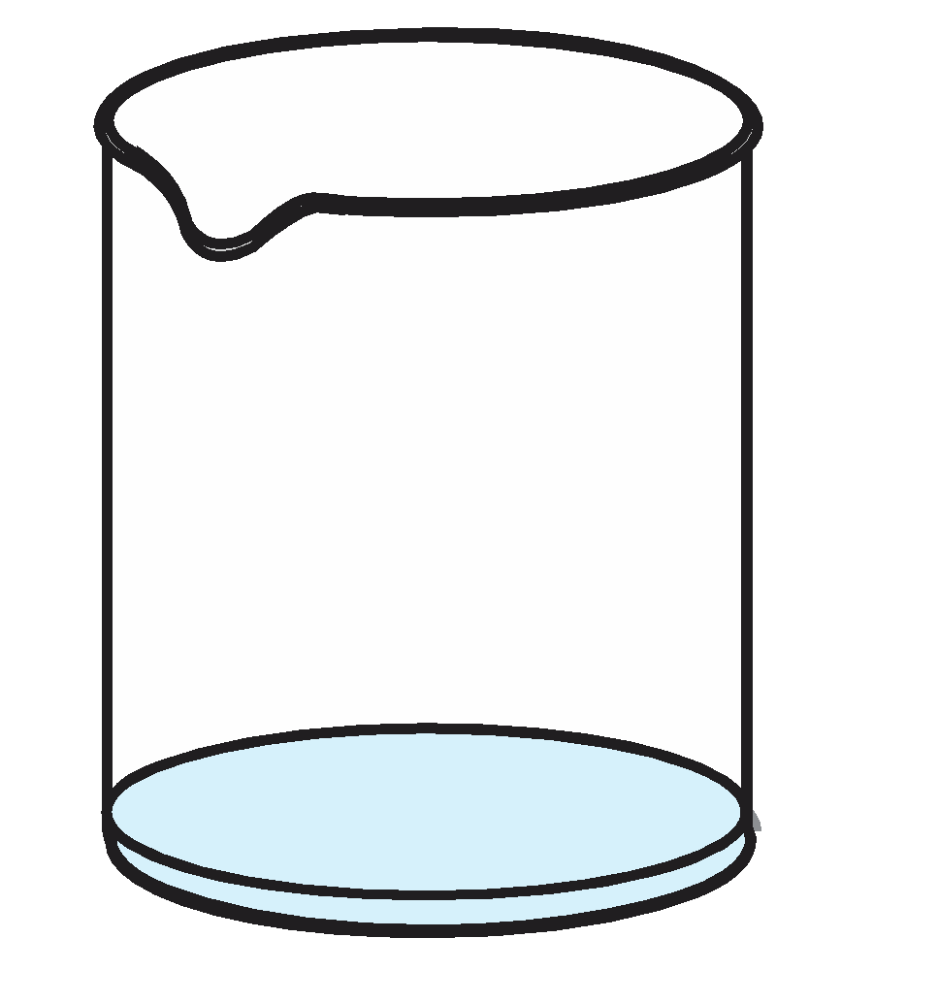
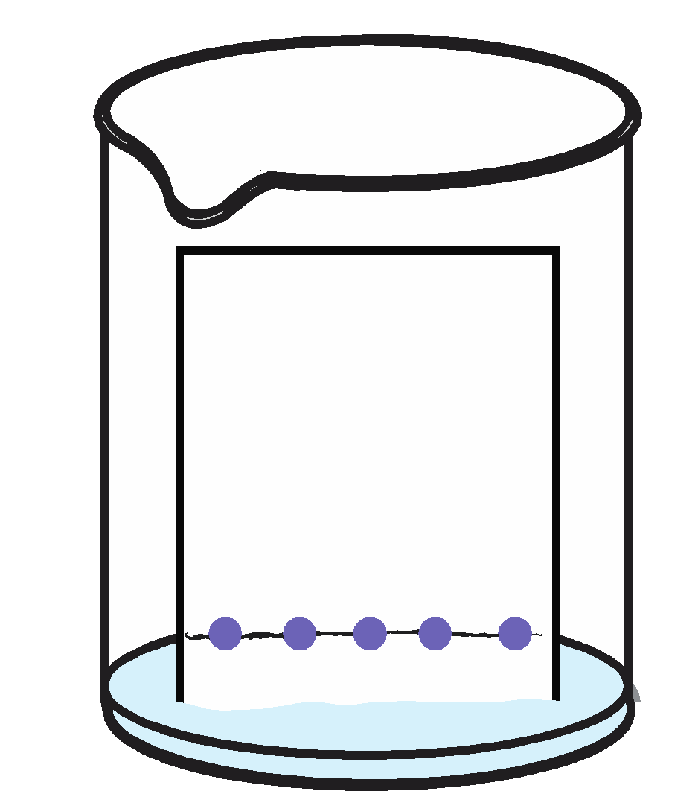
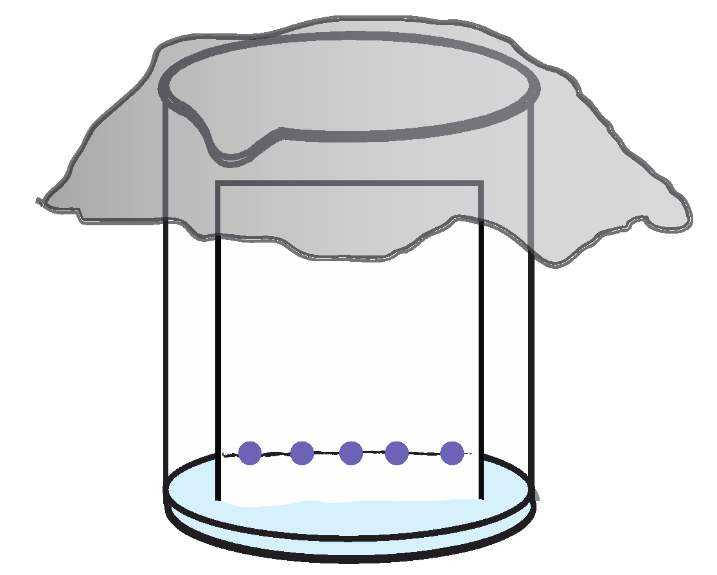
Performing thin layer chromatography
1.
2.
3.
4.
Pour your solvents into the beakers
Place the plate into the beaker so that the bottom is touching the solvent
Allow the solvent to diffuse through the plate, moving the samples through the matrix
Analyze the results
Notes:
Pour your solvent into the cup (I’ve got two buffer systems here, one which is sodium citrate and isopropanol which is less polar than the other which is aqueous potassium acetate because of the alcohol).
Stand or tape your chromatography paper so that the bottom is touching the solvent
Allow the solvent to diffuse through the paper, moving the dye molecules
Analyze the results

Slide 14
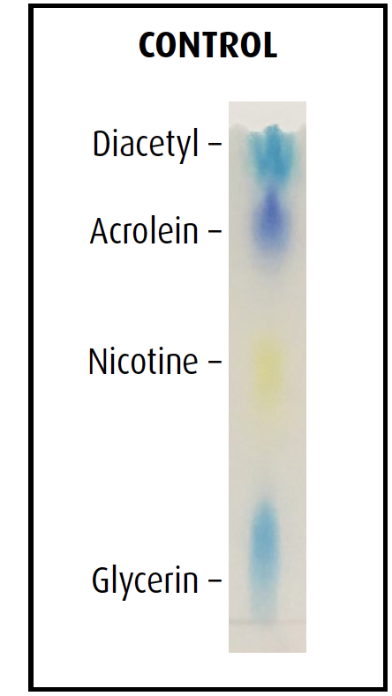
Form your hypothesis: what is in each sample?
Notes:
So, we can ask our students to form hypothesis of which chemicals are in the samples, and then text it. You can have your students research these components to see their effects on human health. Also research and figure out why they migrate the way they do

Slide 15
Mixtures separate based on their chemical properties
http://www.mendelset.com/articles/683/thin_layer_chromatography_tlc
The nature of the solvent and the matrix influences the separation of the mixture
Notes:
So, we talked a little bit about the TLC matrix, now let’s discuss the buffer. Again, this relates to the chemistry of the molecules. The nature of the solvent and the matrix influences the separation of the mixture
Polarity directly affects solubility because polar substances dissolve better in polar solvents and non-polar substances dissolve better in non-polar solvents. By selecting different mobile and stationary phases scientists can isolate a wide range of chemicals.

Slide 16
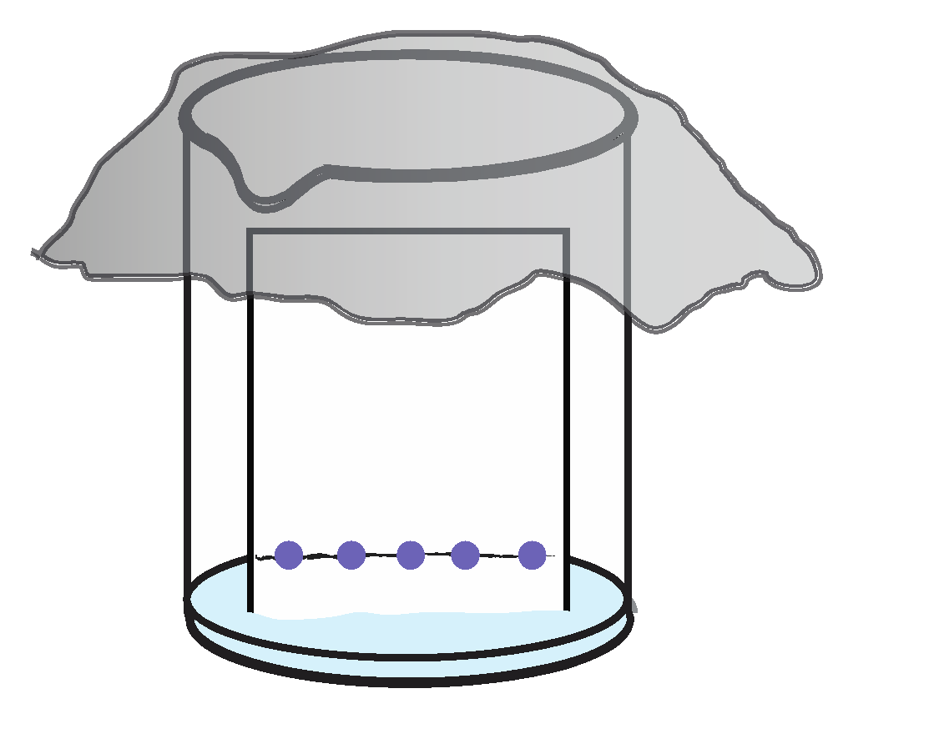
Principles of thin layer chromatography
Solvent travels up the TLC plate
Soluble molecules travel up the plate with the solvent
Insoluble molecules stay at the bottom of the plate or move slowly
Retention factor is the ratio of the distance the solute traveled to the distance the solvent traveled.
Notes:
When compounds are spotted onto a TLC plate and placed in a solvent, they will separate on the plate either by moving with the solvent as it travels up the plate or by adhering to the plate and not travelling with the solvent. Different solvents and plate polymers can give different TLC results.
Sample molecules will have a preferred distribution between the stationary and mobile phases depending on
their structure. Samples that have little or no solubility in the mobile phase and high solubility in the stationary phase will migrate slowly. Conversely, samples that have little solubility in the stationary phase but are
highly soluble in the mobile phase will have the fastest migration rates.
The retention factor is the ratio of the distance the solute traveled to the distance the solvent traveled. SO when the experiment is finished, we can calculate these values for the different dyes and it will help us analyze our results.

Slide 17
Industrial applications of thin layer chromatography
Clinical, pharmaceutical, food, and cosmetic laboratories use TLC to identify compounds in mixtures
Researchers assay the completeness of chemical reactions using TLC
When coupled with spectroscopy, TLC identifies specific components
https://www.sciencedirect.com/science/article/abs/pii/S0039914015302873
Notes:
Clinical, pharmaceutical, food, and cosmetic laboratories use TLC to identify compounds in mixtures
Researchers assay the completeness of chemical reactions using TLC
When coupled with spectroscopy, TLC identifies specific components

Slide 18
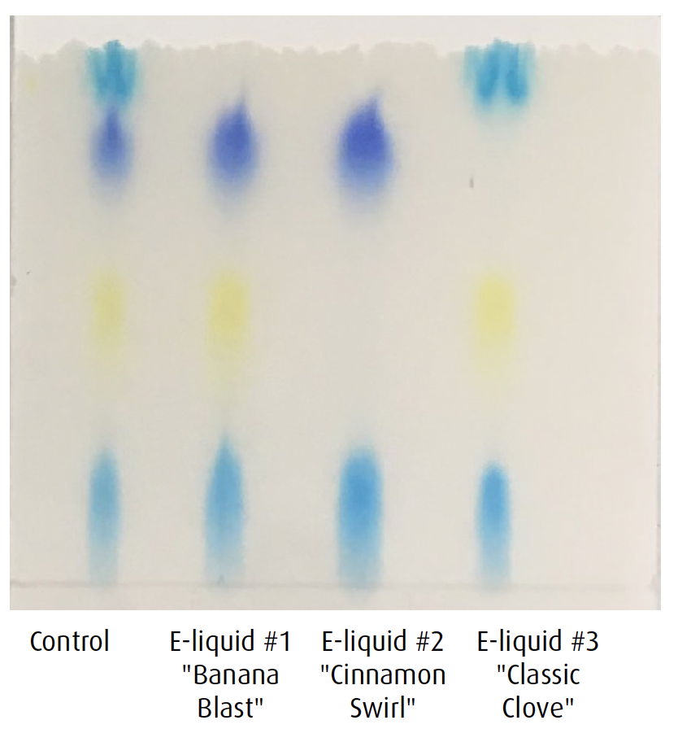
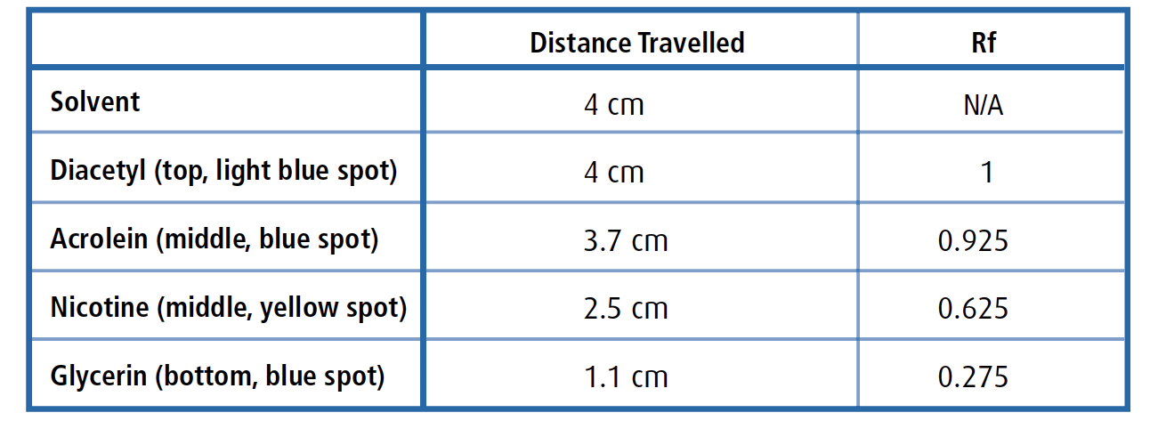
Results and analysis
Notes:
Which molecules are present? How did they move differently based on the solvents?

Slide 19
EDVOTEK, Inc. The Biotechnology Education Company
To Request this Presentation:
https://forms.gle/S23adwaLV2PMN5TS9
For Orders & Technical Service:
Phone: 1-800-EDVOTEK (1-800-338-6538)
Web site: www.edvotek.com
Email: info@edvotek.com
Check out our YouTube Channel:
www.youtube.com/EdvotekInc
Follow our social media for offers & updates:
www.facebook.com/edvotek
https://twitter.com/edvotek
https://www.instagram.com/edvotek
Notes:
We will be posting the presentation and the slides in the next few days to our website www.edvotek.com. If you’d like us to email you when they are available, please fill out this form and we will contact you in a few days. Now, I am happy to answer a few questions.
Thanks so much for your time. If you need us, please reach out to us at info at edvotek dot com, or try one of our social media channels. We look forward to helping you get biotechnology into your classroom! Stay safe, everyone.

