Slide 1
Teaching the ELISA using Public Health: HIV Biology and Detection
Danielle R. Snowflack, Ph.D.
www.edvotek.com
Notes:
Hi everyone, and welcome to another biotechnology live stream! My name is Danielle Snowflack, and I am the Senior Director of Education at Edvotek. We’re so happy to bring this biotechnology training workshop to you!

Slide 2
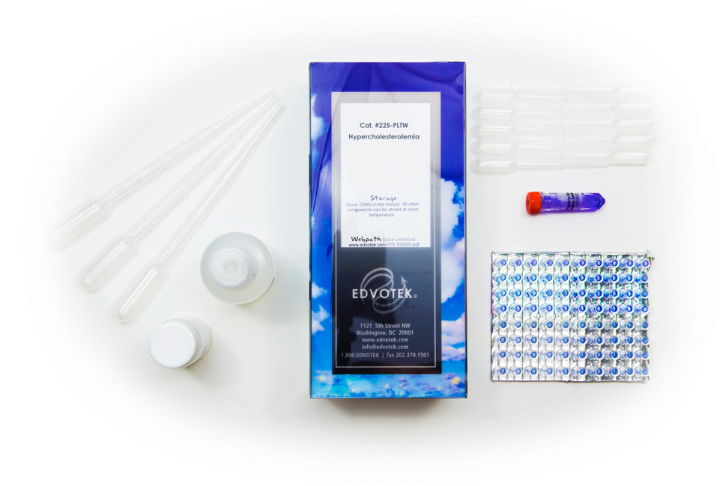
EDVOTEK The Biotechnology Education Company
Celebrating OVER 30 years
of science education!
Notes:
For those of you who are unfamiliar with Edvotek, we are the Biotechnology education company! We were founded over 30 years ago now by Dr. Jack Chirikjian, a professor of biochemistry at Georgetown University. Edvotek was born to translate exciting developments in the word of biotechnology into the classroom. And thus, Edvotek was born. We work with educators all over the world to demystify science and foster the next generation of scientists through hands-on, active learning activities. But, we also hope to make biotechnology accessible to all labs, research, outreach, biohacker, and education.

Slide 3
www.edvotek.com/contest
Notes:
Before we get to the ELISA, I want to let you know about our EdvoCycler Junior giveaway. The Edvocycler Jr is a 16-place thermal cycler with active heating and cooling. No strings (or tablets) attached. And now $699. If you’re really looking to supercharge your lab, this is the piece of equipment you need.

Slide 4
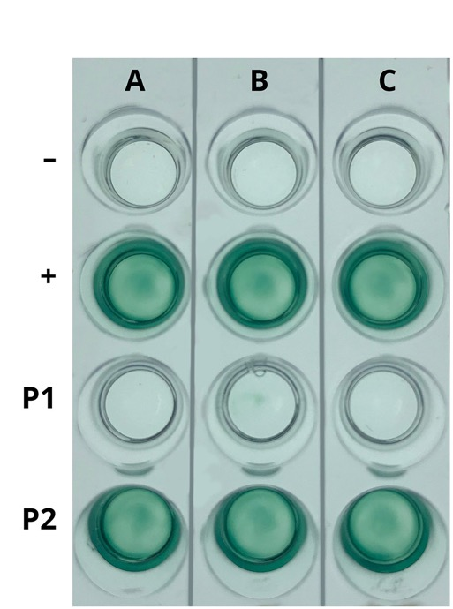
Today’s Experiment: HIV Antibody Test
The ELISA detects the presence of specific molecules within a sample.
Today’s Experiment: Edvotek Kit 271: Simulation of HIV Detection by ELISA.
This test simulates the medical test that identifies the presence of HIV antibodies and antigens in patient samples.
Notes:
The experiment we’re running today is Edvotek Kit 271: Simulation of HIV Detection by ELISA. This Enzyme-Linked Immunosorbent Assay, or ELISA, is a highly sensitive test that uses antibodies to detects the presence of specific molecules within a complex sample. Today, we’re talkig about test looks for the presence of HIV antibodies in the blood which diagnoses infection. I’ll run this assay from start to finish over the course of this workshop. While the experiment is running, we will talk about the virus using Origami Organelles, the ways clinicians test for the virus using the ELISA, and methods to identify and trace the spread of the virus.
This demonstration will be recorded, and our slides will be available on our website. If you’d like to be notified when they’re posted, please fill the form – the link will be in the chat box. We are also offering professional development certificates to those who watch live! This link will only be live for one hour after the presentation, so be sure to complete it before 430 PM Eastern Standard Time.

Slide 5
HIV/AIDS is a serious, worldwide public health challenge
Over 37 million people worldwide live with HIV
Many people do not have access to care or treatments, and HIV-positive patients are frequently unaware of their infectious status.
Testing, tracing, and education helps public health workers control the spread of disease.
https://ourworldindata.org/hiv-aids
Notes:
HIV/AIDS is a serious, worldwide public health challenge, and it has been since it was first identified as a problem in the early 1980’s. HIV affects millions of people around the world – today, over 37 million people worldwide live with HIV. Now, in the USA, we’re fortunate because we have a well-developed public health system with tracking, tracing, and treatment. Worldwide, many people do not have access to care or treatments, and HIV-positive patients are frequently unaware of their HIV status. This leads to further spread of the virus.
Now, in order to interrupt the spread of disease, public health professions will identify and contact any individuals which may have been exposed to HIV. In addition to allowing researchers to study the distribution patterns of the disease spread, it allows clinicians to provide treatment and counselling to exposed people, to notify possibly infected people so that they do not spread the disease further, and, of course, stop the spread of disease within a community.

Slide 6
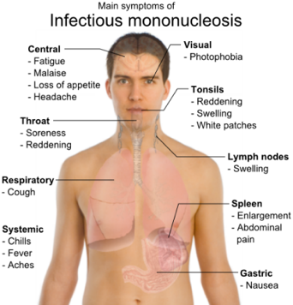
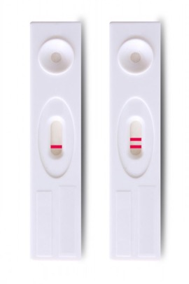
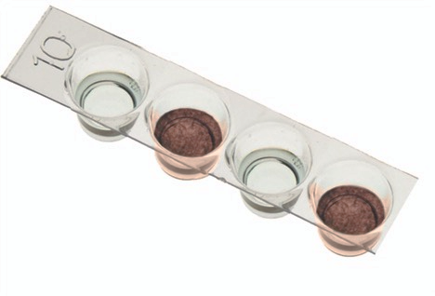
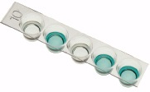
The Enzyme-Linked ImmunoSorbent Assay (ELISA)
The ELISA is a highly versatile test that has been adapted for many uses.
Allergen detection – milk, peanut, egg
Hormones – Pregnancy tests
Toxicology – drug tests
Disease detection – WNV, HIV, TB, Mononucleosis
ELISAs can test blood and other biological samples.
Cat. #279
Cat. #274
Notes:
As I mentioned before, the ELISA uses antibodies to detect the presence of antigens in samples. Since we can generate antibodies to lots of different molecules, the ELISA is highly versatile laboratory test that has been adapted for many uses. For example, you may have an allergy, so you need to be careful about what you eat. Foods that may contain common allergens can be tested by ELISA to indicate that they are safe to eat. We’ve listed a few of the many uses for the ELISA on this slide.
For this workshop, we’ll be discussing the ELISA as it is used in medical testing. The ELISA is commonly used for medical diagnostics, as it is can be used to identify antigens in blood, saliva, urine and other biological samples. If you’ve ever taken a pregnancy test, you’ve already performed an ELISA at home.

Slide 7
The ELISA can be Quantitative or Qualitative
Qualitative: “Yes or No?”
Results are determined by comparing to a known standard.
Quantitative: “How much?”
A “standard curve” is generated using known concentrations of the target molecule
The experimental sample is assayed and the result is compared to standard curve
Human Health ELISA #279
Quantitative ELISA #278
Notes:
The ELISA can be qualitative or quantitative. The qualitative ELISA gives us a Yes or No answer: A strong signal is positive, no signal is negative. One example of a qualitative ELISA that you may be familiar with is a pregnancy test. This at-home ELISA tests urine for the presence of hormone HCG, which is an indicator of pregnancy. You can’t be just a little bit pregnant! When taken at the right time, a pregnancy test will give you a yes or no answer.
In the Qualitative ELISA, we compare results from unknown to results from samples of known concentration. (Advance slide) So back to that example of food allergens. The ELISA is often used to test for the presence of known allergens in food that may be introduced through manufacturing. Here’s a label from some certified gluten-free oats. You can see from the label that they certify to 3ppm, or parts per million.

Slide 8
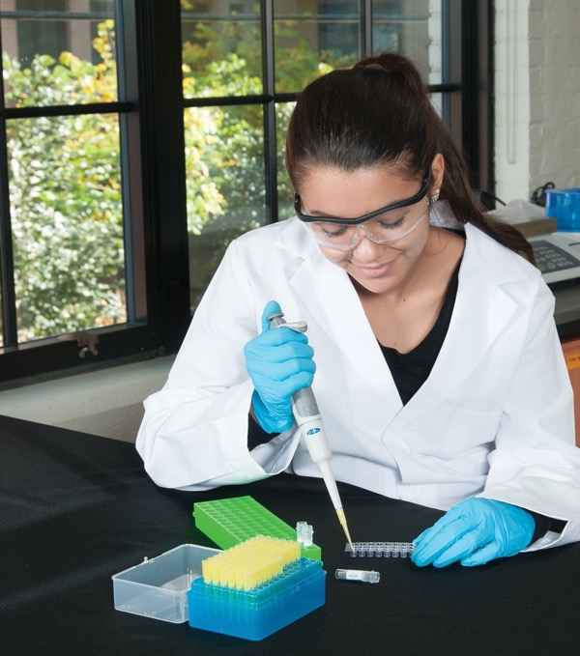
What Do I Need to Perform an ELISA Experiment?
Test Samples
Patient
Control
HIV Antigens
Enzyme-linked Antibody
Substrate
Wash Buffer
Microtiter plate
Transfer Pipet or Adjustable Volume Micropipette
Notes:
So, what do you need to perform the ELISA? Luckily, this experiment is pretty easy to run. Everything you need is included with the kit. I’ll be wearing gloves today, but I just want to emphasize that this experiment is a simulation – there are no live virus or human samples involved.
Test Samples. For many medical tests, this will be blood, or urine, or saliva from the patient.
Patient samples. These are our experimental samples that we are going to test. We don’t know how they are going to turn out, whether they’ll be positive or negative. (Ok, well, maybe you do if you were paying attention a few slides ago.)
Our Control is going to be a sample that we know how the assay should react. A positive control will give a positive result, and a negative control a negative result. If our controls fail, or if our assay does not give the correct results, it represents a learning moment – be sure to have your students analyze and explain what went wrong as carefully as what went right. It’s important to acknowledge that science can be messy. Even experiments that don’t work can teach us important lessons.
HIV antigens. So, for our ELISA, we’re looking for human antibodies that recognize HIV. To do this, we coat the plate with HIV antigens and then look for our patient samples to interact.
Enzyme-linked Antibody – this antibody allows us to detect the presence of HIV proteins and antibodies in patent samples. It is connected to an enzyme that turns over a particular substrate, producing either color or light, which we can visualize.
Buffer. This is generally used to dilute antibodies and wash wells.
Microtiter plate. This is a thin piece of plastic with multiple little wells. Each well serves as a separate mini test tube of sorts. When doing the experiment, each well is an individual reaction done in parallel with the other reactions.
Finally, we need to get the samples and reagents into the wells. To simplify today’s demonstration, I’m going to use the transfer pipets. So, we can run this experiment without any special equipment.

Slide 9
Protocol: Simulation of HIV Antibody Test
LABEL the plate and the pipets.
ADD three drops of the HIV antigen solution to each well.
INCUBATE for five minutes.
REMOVE liquid from wells and WASH with buffer 2X.
ADD three drops of the negative control to the first row and positive control to the second row.
ADD three drops of the Patient 1 sample to the third row and Patient 2 sample to the fourth row.
INCUBATE for 5 minutes.
REMOVE liquid from wells and WASH with buffer 2X.
ADD three drops of detection antibody to each well.
INCUBATE for five minutes
REMOVE liquid from wells and WASH with buffer 2X.
ADD three drops of the substrate solution into each well
OBSERVE your results.
Notes:
OK, so let’s get started. We’re going to work through this entire protocol, step by step. While the samples are incubating, I’m going to tell you more about the ELISA, and we’ll discuss HIV.
So, we’re going to do the first three steps in our protocol, highlighted here in red. The first thing we’d do to prepare for the ELISA is to label our microtiter plate and our transfer pipets. But, using a little movie magic, that’s already been done! The last thing I’m sure you want to watch is me labeling pipets.
Using the appropriate transfer pipet, I’m going to add three drops of my simulated HIV antigens to each of the wells. These antigens will bind to any antibodies present in the patient sample. We’ll give this a few minutes to incubate before moving on to the next step.

Slide 10
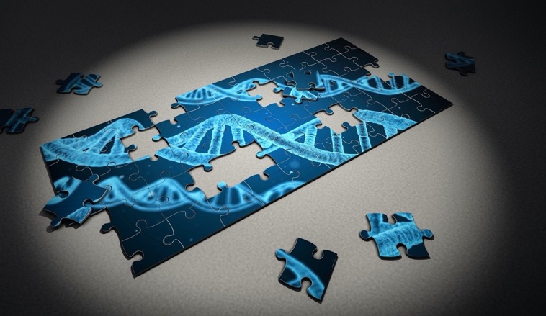
Antibodies Distinguish Between “Self” and “Non-self”
Antibody molecules comprise four linked polypeptide chains: two “heavy chains” and two “light chains” that are connected by disulfide bonds.
The amino acid sequence of the antigen binding site is variable, allowing each antibody to recognize a unique epitope (a particular location within an antigen).
Notes:
While the samples are incubating, let’s talk about antibodies, which are also called immunoglobulins. These specialized proteins are made by our immune system to differentiate between self and non-self proteins or polysaccharides. We call these non-self proteins and polysaccharides antibody generators, or antigens. Each antibody is a y-shaped molecule composed of four polypeptide chains: two “heavy chains” and two “light chains”. The polypeptides are linked together by disulfide bonds. Now, if we were to compare the amino acid sequence of two antibodies, the vast majority of the sequence is the same. However, the amino acid sequence of the antigen-binding site (the little pocket at the end of the Y) is variable, allowing each antibody to recognize a unique epitope (a particular location within an antigen). Since the sequence can be so variable, antibodies can recognize a lot of different molecules.
You can imagine antibody-antigen connection like puzzle pieces. There are a lot of different pieces that are similar, but they lock together when there’s a match. This marks the antigen – whether it is an invading bacteria or virus, or a cancer cell – for destruction by the immune system. Because of their specificity, antibodies can be used to detect the presence of specific biomolecules (i.e. peptides, proteins, antigens and hormones) in a complex sample.

Slide 11
The Immune System Produces Many Antibodies to Detect an Antigen
Antibodies can be polyclonal (heterogeneous mixture) or monoclonal (directed against a single epitope).
Image credit: www.creative-diagnostics.com
Notes:
Antibodies are produced when animals (i.e. rabbits, mice and guinea pigs) are injected with an antigen. Since many different immune cells within the animal produce antibodies in response to the antigen, the serum will contain a mixture of antibodies that vary in their ability to bind the antigen. This mixture of antibodies is called polyclonal. If we isolate and culture individual immune cells from these animals, we can create a monoclonal antibody that recognizes a single epitope.
So, let’s think about our antigen like a water bottle. The hand in this picture is holding the bottom corner of the water bottle. We can think of that as one antibody recognizing a single epitope. This would be a monoclonal antibody. Now, if we were holding the cap of the water bottle simultaneously, we’d be recognizing two sites on the water bottle, not just one. This is like a polyclonal antibody.
Now, one type of antibody isn’t necessarily better or worse than the other. Both types can be used in a wide array of experiments, from the ELISA, to staining cells, or doing a western blot. The most important thing is, when developing an assay, to take the time and care to select the best antibody for your application. To be used in the laboratory, antibodies must have a specific, robust and reproducible interaction with their antigen. Antibodies that have a high affinity for non-specific antigens will have unwanted cross-reactions that can result in high backgrounds. In contrast, an antibody with a weak affinity may not be sensitive enough for antigen detection. These antibodies would produce results with a high false-positive or false-negative rate.

Slide 12
The ELISA Detects Specific Antigens in Complex Mixtures
The sample is added to the wells of the microtiter plate, where it adheres to the plastic through hydrophobic and electrostatic interactions.
After washing away any excess sample, the wells are “blocked” with a protein-containing buffer to prevent non-specific interactions.
The primary antibody is added to the wells, where it recognizes the antigen and binds through electrostatic interactions. Excess antibody is washed out of the wells.
Notes:
There are many protocols for the ELISA, but they all rely on using antibodies to detect the presence of antigens in experimental samples, and they follow the same basic principles. First, we add our sample, where it sticks to the plastic walls of our microtiter plate through hydrophobic and electrostatic interactions.
After washing away any excess sample, the wells are “blocked” with a protein-containing buffer to prevent non-specific interactions. This is important, because proteins are also antibodies that can stick to the wells. For the ELISA we’re performing today, we simplified things so that we don’t need the blocking step. We then add the primary antibody to each well. If the antigen is present, the antibody binds through electrostatic interactions. Excess antibody is washed out of the wells. In this ELISA, our antibodies come from the patient samples

Slide 13
The ELISA Detects Specific Antigens in Complex Mixtures
The secondary antibody, which recognizes the primary antibody, is added to the wells. If the antibody-antigen complex has formed in the well, it will remain in the well after the wells are washed.
The enzyme-linked secondary antibody allows us detect the presence of the antibody-antigen complex when the substrate is added to all the wells.
Chromogenic detection
Fluorogenic detection
The ELISA detects low antigen concentrations because each enzyme can produce many product molecules.
Notes:
The secondary antibody, which recognizes the primary antibody, is added to the wells. If the antibody-antigen complex has formed in the well, it will remain in the well after the wells are washed.
The secondary antibody is covalently linked to an enzyme that allows for the detection of the antibody-antigen complex. A clear, colorless substrate solution is added to each well. In wells where the secondary antibody is present, the enzyme turns the clear substrate solution to blue. Since most enzymes have a high catalytic activity, meaning that they can quickly turn over the substrate, this assay allows us to quickly detect even the smallest amount of antibody.

Slide 14
Summary of ELISA Protocol
Notes:
So, let’s think about our the complex we’ve built as an ice cream cone. (Advance) The cone is our antigen, which binds to the microtiter plate. Each scoop of ice cream is an antibody in our complex – the first scoop is our primary antibody, and the second is our enzyme-linked secondary antibody. We’re building a complex on top of our antigen.

Slide 15
Protocol: Simulation of HIV Antibody Test
LABEL the plate and the pipets.
ADD three drops of the HIV antigen solution to each well.
INCUBATE for five minutes.
REMOVE liquid from wells and WASH with buffer 2X.
ADD three drops of the negative control to the first row and positive control to the second row.
ADD three drops of the Patient 1 sample to the third row and Patient 2 sample to the fourth row.
INCUBATE for 5 minutes.
REMOVE liquid from wells and WASH with buffer 2X.
ADD three drops of detection antibody to each well.
INCUBATE for five minutes
REMOVE liquid from wells and WASH with buffer 2X.
ADD three drops of the substrate solution into each well
OBSERVE your results.
Notes:
Okay, so now we are going to add our control and our patient samples. Now, we want to be very careful not to cross-contaminate samples, so we are going to be sure to use the correct pipet for each sample. Again, if the experiment doesn’t work out as expected, this is another place to talk to your students about experimental error. In their lab reports, have your students talk about the places in the protocol where mistakes were made based on their results. For example, if our positive control was negative, they may have used the wrong control sample.
In this step, we add the patient samples. This assay is going look for specific antibodies in our samples that suggest that a person has been infected by HIV.

Slide 16
HIV and AIDS
HIV, or Human Immunodeficiency Virus: the name of the virus responsible for the AIDS pandemic.
AIDS, or Acquired Immunodeficiency Disease: the disease caused by HIV.
Initial infection by HIV may cause flu-like symptoms within 2-4 weeks of infection
The progression to AIDS is characterized by the deterioration of an individual’s immune system. This allows infectious agents to invade the body and propagate unchecked.
Image credit:
Mikael Häggström, MD
Notes:
So, a few important definitions. HIV, or Human Immunodeficiency Virus is the name of the virus responsible for the AIDS pandemic. It’s a retrovirus that spread through contact with blood, semen, or other bodily fluids. Initial infection by HIV may cause flu-like symptoms within 2-4 weeks of infection, but it is generally quite mild. However, after time – sometimes up to 10 years after infection – HIV will progress to AIDS, or Acquired Immunodeficiency Disease. The progression to AIDS is characterized by the progressive deterioration of an individual’s immune system. This allows infectious agents to invade the body and propagate unchecked. And so a hallmark of AIDS is the development of rare diseases and cancers that the body cannot fight off, and it is usually these diseases that ultimately result in death.

Slide 17
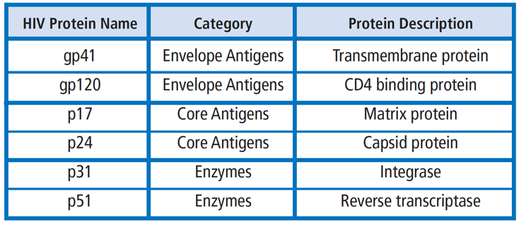
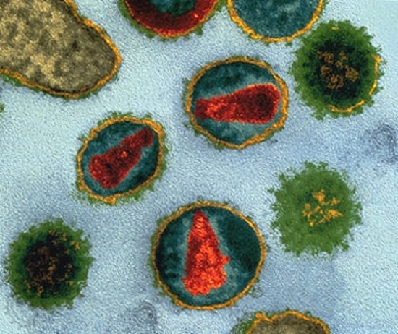
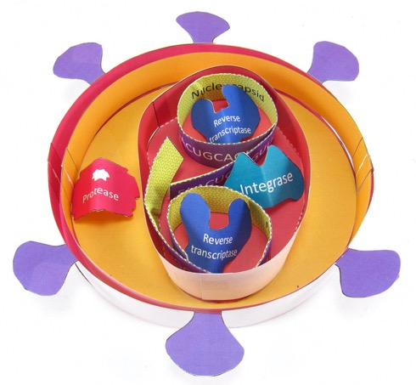
Anatomy of HIV
Retroviruses are RNA viruses that make a DNA copy of their genome before inserting it into the host DNA.
HIV has a single-stranded RNA genome wrapped in a cone-shaped capsid.
A host-derived membrane envelope surrounds the capsid.
The envelope is studded with proteins that help the virus infect cells.
EVT-138
Notes:
Okay, so now let’s get to the virus itself. Viruses are simple infections particles that cannot replicate independently – they are dependent on the cellular machinery within their specific host. Because viruses carry genetic material, reproduce and evolve but rely entirely on a host organism for their basic biological functions, they’re considered to be on the border of biology and chemistry.
The Human Immunodeficiency Virus or HIV, which we’re talking about today, is a sneaky virus. Once inside the body, the virus evades the immune system and integrates itself into the human genome where it is dormant until later activated. When the virus is active, it lowers the effectiveness of the human immune system, leaving the patient vulnerable to many opportunistic diseases. Specifically, HIV is a retrovirus, which is a family of viruses that use a special enzyme called reverse transcriptase, or RT, that uses RNA as a template to create DNA molecule. The DNA is then integrated into the host genome, where it hides out. And this means that even after the initial symptoms of infection pass, the virus sticks around in the body.
The ‘retrovirus’ family of viruses contain two copies of the single-stranded RNA genome. In total, the HIV genome encodes for 19 proteins necessary for the virus’s structure, integration, replication, and disruption of the host cell. The RNA is capped and polyadenylated, just like our cellular messenger RNA. The genome is contained within a conical protein capsid built from the p24 protein. The core also contains many molecules of reverse transcriptase. A lipid membrane envelope surrounds the capsid. This membrane is derived from the host cell membrane during budding. The capsid and the membrane protect the RNA genome from the outside environment. The envelope is studded with proteins that help the virus infect cells. They interact with receptors on the surface of the cells in our immune system, like helper T cells, macrophages, and dendritic cells. This lets them invade the cells, where they take over the cell’s machinery and reproduce.
<Advance> Here’s an image of HIV collected using electron microscopy, which lets us visualize objects that are mere nanometers in width. We can see the core, envelope and the membrane-embedded proteins very clearly in this image.

Slide 18
The HIV life cycle
HIV enters cells and begins to replicate itself by making new viral RNA and proteins.
At the same time, the virus uses an RNA-dependent DNA polymerase to make DNA copies of the RNA genome, which it inserts into the host cell’s DNA.
Upon infection, the body begins to fight the viral infection, generating antibodies
Notes:
So, after HIV gets into the bloodstream, it uses its surface proteins to bind with receptors on immune cells. This allows the membrane of HIV to fuse with the membrane of the cell, releasing the protein core into the host cell. Reverse transcriptase creates a DNA template from the RNA genome that will integrate into the patient’s genome. Once inserted into the host cell’s genome the viral DNA can lie dormant for long periods of time, known as the latent stage of infection. During active viral production the DNA will be transcribed into mRNA, which can initiate production of viral proteins. The proteins and RNAs assemble at the surface of the cell, forming a new virus particle. Finally, the completed virus buds off from the cell membrane and is ready to infect healthy T-cells.

Slide 19
Genomic variants of HIV
There are two types of HIV that infect humans.
HIV-1 is the most common type of virus, responsible for ~95% of all HIV infections worldwide.
HIV-2 is mostly found in West Africa and surrounding countries. It is progresses more slowly than HIV-1, resulting in fewer fatalities.
HIV-1 has four major groups based on the genome sequence, and several strains within the group
www.avert.org/professionals/hiv-science/types-strains
Notes:
There are two main types of HIV that can cause disease in humans. The first and most common form of the virus is HIV-1, which is responsible for ~95% of all HIV infections worldwide. HIV-2 is mostly found in West Africa and surrounding countries. It is progresses more slowly than HIV-1, resulting in fewer fatalities.
To learn more about the virus, researchers sequence patient HIV genomes. Reverse transcriptase is very error prone, meaning that it often creates mutations within the genome. Researcher has shown that HIV-1 has four major groups based on the genome sequence, and several strains within the group. The major group, or M, is found in over 90% of people infected with HIV-1. The M strain is further separated into nine strains, which are further separated into sub-strains. There is much scientific discussion over whether these sub-strains are more or less infectious, whether disease progresses more quickly in some sub-strains over others. But, the information is important because it can help researchers follow the spread of disease, to learn how the virus is evolving so researcher can get ahead of it, and also to prescribe a course of treatment.

Slide 20
Protocol: Simulation of HIV Antibody Test
LABEL the plate and the pipets.
ADD three drops of the HIV antigen solution to each well.
INCUBATE for five minutes.
REMOVE liquid from wells and WASH with buffer 2X.
ADD three drops of the negative control to the first row and positive control to the second row.
ADD three drops of the Patient 1 sample to the third row and Patient 2 sample to the fourth row.
INCUBATE for 5 minutes.
REMOVE liquid from wells and WASH with buffer 2X.
ADD three drops of detection antibody to each well.
INCUBATE for five minutes
REMOVE liquid from wells and WASH with buffer 2X.
ADD three drops of the substrate solution into each well
OBSERVE your results.
Notes:
Let’s get back to our ELISA. We’re going to wash our patient samples out of our wells. Next, we’re going to add our enzyme linked detection antibody to each well of this plate. Once the antibody is added, we’re going to incubate again to allow the complex to form.

Slide 21
Timeline of HIV research
Evidence shows that HIV may have been infecting humans since the early 1900’s, but widespread infection began in the 1970’s
In 1983/84, researchers identified the virus and learned how it spread
By 1997, AIDS deaths declined from testing and treatment
With the advent of antiretroviral therapy, HIV has become a chronic condition with fewer people progressing to AIDS.
For a timeline of public health measures: https://npin.cdc.gov/pages/hiv-and-aids-timeline#1980
Notes:
HIV is closely related to primate retroviruses, and it is believed to have made the jump from primates in the early 20th century in west Africa. This was a time of urbanization and colonization in Africa, likely bringing humans in contact with infected animals. Scientists were able to reconstruct the early HIV genome from preserved human and primate samples. And looking back at historical records, there were people who died from immune system decline that couldn’t be linked to other disease. But, worldwide infection from HIV began in the 1970’s. Given that it can take years for HIV to progress to AIDS, the initial spread of the disease went largely unchecked. But, in the late 70’s and early 80’s, researchers began to see widespread spread of the disease, especially in gay communities where there was a higher incidence of unprotected intercourse. And this did lead to a lot of prejudice related to people with HIV/AIDS, but we also know that the disease did also spread through heterosexual relationships, blood banks, intravenous drug use, and even in utero. And so we found ourselves in the midst of a pandemic – that is the outbreak of disease in many different geographic regions, affecting a substantial number of people. And, given the trends we still see in infection rates, we remain in an HIV pandemic. While infection rates are declining, millions of people will be infected each year, and hundreds of thousands of people will die, most from lack of treatment.
In 1983/84, several research groups identified the virus responsible for HIV and learned how it spread. They identified that casual contact – hugging, shaking hands, sharing dishes – and instead could only be spread through contact with specific bodily fluids. They also learned that outside the body, HIV only lasts several hours. Researchers developed tests to identify the virus, which helped to slow the spread.
By 1997, AIDS deaths declined from these tests, but also from treatment. These medications, including antiretroviral therapies prevent the virus from reproducing in the body, meaning that the virus can’t spread between individuals, but also that the virus cannot activate and cause the immune system failure indicative of AIDS. With these therapies, HIV has become a chronic condition, and HIV positive patients can live full lives.

Slide 22
Prevention is the Best Medicine
HIV spreads through direct contact with some body fluids (blood, semen, rectal and vaginal fluids, human milk)
To prevent infection, minimize high-risk behaviors (unprotected sex, needle sharing).
If involved in high-risk activities, regular testing and PrEP/PEP help to prevent spread.
If you are exhibiting symptoms, contact your healthcare professional for guidance.
There is no cure for HIV. Treatment includes Antiretroviral therapy (ART), which can reduce viral levels to undetectable.
Notes:
Luckily, with proper precautions, we can prevent the spread of HIV. The virus spreads from person-to-person through direct contact with certain body fluids. And, since we know the mode of transmission between people, we can take steps to protect ourselves from transmission by reducing our high-risk activities. For example, it is important to practice safer sex practices, including the correct use of condoms, to prevent fluid exchange. Needle exchange programs exist to provide new, sterile syringes to drug users to help protect people. People who are pregnant can be given antiretroviral therapy to prevent transmission to the developing fetus. And these have been shown to be effective methods to reduce transmission.
If a person is engaged in high-risk activities, they can also take antiretroviral therapies in a protective context, either through pre-exposure prophylaxis (PReP) or post-exposure prophylaxis (PEP). These medications can prevent HIV from establishing an infection. But, people must also be honest with their partners, through testing and discussion, to help prevent transmission.
Even while taking precautions, the most important thing is that if you are exhibiting symptoms of HIV, please reach out to your doctor or your local public health officials. There is a lot of information on the internet about the HIV/AIDS on the internet, some of which is intentionally misleading. The best source of information will come from the Centers for Disease Control and Prevention (CDC) or the World Health Organization.
There remains no cure or vaccine for HIV, though researchers are working on them. But HIV positive people, through ART, can live long, healthy lives. With the right medications, the viral load can become undetectable, which clinicians believe means that an HIV positive person cannot spread the virus to their partners.

Slide 23
Diagnosing HIV
There are several diagnostic tests to confirm HIV infection: Nucleic Acid Test (NAT), Immunoassay, and Western Blot.
NAT uses RT-PCR to test for the presence of the viral genome.
Immunoassays test for the presence of antibodies to HIV or HIV proteins
Western Blot tests for individual HIV proteins
Notes:
If you have symptoms and a likely exposure, you will be tested for HIV. Even without exposure, you may be tested, for example if you’re pregnant. Today, there are three diagnostic assays to confirm HIV infection.
The Nucleic Acid Test uses Reverse-Transcription PCR to identify the presence for the viral genome in patient samples. This test is very sensitive and can detect infection within days of infection.
Immunological tests like the ELISA been developed to identify the presence of antibodies to HIV in patients, and also to detect the presence of HIV proteins that are produced from viral replication.
Western blotting also uses antibodies to detect the presence of a specific protein, but those proteins have been separated by SDS-PAGE and transferred to a membrane.

Slide 24
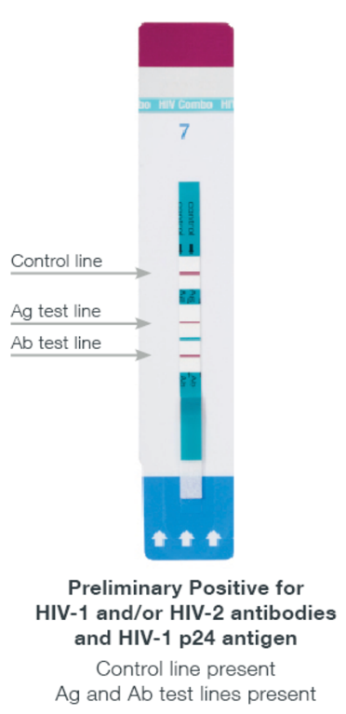
The HIV Antibody/Antigen Assay
Fourth generation tests identify multiple indicators of infection
HIV p24 Antigen, which develops earlier in infection than antibodies
Anti-HIV IgG and IgM Antibodies
Fast, accurate testing is the first step in managing infections.
Notes:
Most fourth-generation ELISAs for HIV identify two different antibodies in patient samples: IgM and IgB. The IgM antibody serves as the first line of defense against the HIV virus. These very large antibodies are able to bind to pathogens and label them for inactivation by the immune system. As the body adapts to create long-term immunity to the virus, IgG antibodies are produced in the plasma B-cells. These antibodies are part of the adaptive immune system. The presence of high levels of this antibody signifies late stages of infection. Many fourth-generation tests also use antibodies to detect the presence of p24, the capsid protein, which can be detected relatively soon after HIV infection.
https://www.dshs.state.tx.us/lab/PDF/Lab-Directors-Conference/presentDetHIV12AgAbComboClinic.doc

Slide 25
Protocol: Simulation of HIV Antibody Test
LABEL the plate and the pipets.
ADD three drops of the HIV antigen solution to each well.
INCUBATE for five minutes.
REMOVE liquid from wells and WASH with buffer 2X.
ADD three drops of the negative control to the first row and positive control to the second row.
ADD three drops of the Patient 1 sample to the third row and Patient 2 sample to the fourth row.
INCUBATE for 5 minutes.
REMOVE liquid from wells and WASH with buffer 2X.
ADD three drops of detection antibody to each well.
INCUBATE for five minutes
REMOVE liquid from wells and WASH with buffer 2X.
ADD three drops of the substrate solution into each well
OBSERVE your results.
Notes:
So now we are going to add our substrate. Remember, the substrate interacts with the enzyme that is linked to our detection antibody. IN this case, we’re performing a colormetric ELISA, which means you should be able to detect the results with the naked eye. Keep an eye on the samples as I add the substrate to see if you can detect the color change.

Slide 26
Results and Conclusions
Sample | Observations
1. Negative Control | Clear (no anti-HIV antibodies)
2. Positive Control | Green (anti-HIV antibodies present)
3. Patient Sample 1 | Clear (no anti-HIV antibodies)
4. Patient Sample 2 | Green (anti-HIV antibodies present)
Notes:
In this simulated medical test, we used the ELISA to detect the presence of anti-HIV antibodies in a patient’s blood sample. We can see our positive and negative controls change color appropriately – the positive control is blue, and the negative control is clear. In patients that have been infected with the virus, the ELISA will detect the IgG and IgM antibodies and a color change reaction will be seen. In contrast, a patient who was not infected with HIV will not have the antibodies and there will be no color change. So, looking at this plate, patient two has HIV antibodies in their blood, and patient one does not.

Slide 27
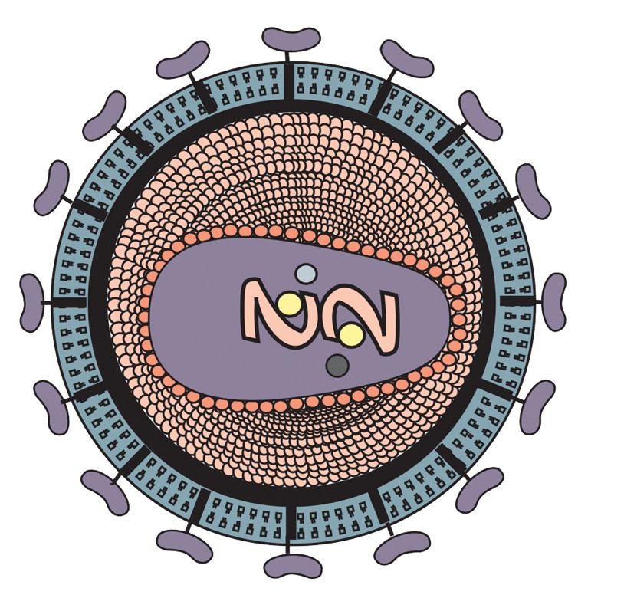
Using the ELISA to test for HIV
The retrovirus HIV inserts its genome into the host DNA.
HIV is a major public health concern worldwide.
Initial symptoms of HIV are mild. As the disease weakens the immune system, patients are susceptible to infection.
Screening using the ELISA identifies HIV antibodies and antigens in patient samples
Early detection is important for treatment of the disease and to prevent spread.
For the most up-to-date information, visit www.cdc.gov/hiv
Notes:
So, we’ve come to the end of the experiment! We’ve covered a lot of information over the course of this experiment. We talked about HIV, the retrovirus responsible for the AIDS pandemic. While initial symptoms of HIV are flu-like, progression of the disease weakens the immune system, leaving patients susceptible to infection.
The spread of HIV remains a major public health concern worldwide, especially in areas of the world where treatment is unavailable. There, the disease can spread unchecked, especially within vulnerable communities.
Detection relies on patient screening using medical tests. In this workshop, we simulated the HIV ELISA, which identifies HIV antibodies and antigens in patient samples. The ELISA has evolved into a powerful and versatile biotechnology technique that can be applied to many different diagnostic scenarios. And, using these tests, which can even be done at home, we can detect HIV earlier and thus be able to treat the disease quickly, as well as prevent its spread.
I know teaching this can be a little scary, especially because there are controversial and uncomfortable aspects to teaching about HIV. But, that makes this the perfect vehicle to teach your students about virology, epidemiology, and medical testing in the context of current events. Your students are likely curious to learn more. It’ll also help combat misinformation that can spread like wildfire, and help your students become advocates for their own personal health. For the most up-to-date information, and more resources, be sure to visit the CDC website.

Slide 28
EDVOTEK, Inc. The Biotechnology Education Company
To Request this Presentation:
https://forms.gle/nN19Lwb5ajYVJ3N47
For Orders & Technical Service:
Phone: 1-800-EDVOTEK (1-800-338-6538)
Web site: www.edvotek.com
Email: info@edvotek.com
Check out our YouTube Channel:
www.youtube.com/EdvotekInc
Follow our social media for offers & updates:
www.facebook.com/edvotek
https://twitter.com/edvotek
https://www.instagram.com/edvotek
Notes:
We will be posting the presentation and the slides in the next few days to our website www.edvotek.com. If you’d like us to email you when they are available, please fill out this form and we will contact you in a few days. Now, I am happy to answer a few questions.
Don’t forget about our contest!
Thanks so much for your time. If you need us, please reach out to us at info at edvotek dot com, or try one of our social media channels. We look forward to helping you get biotechnology into your classroom! Stay safe, everyone.

