Slide 1
The Sweet Laboratory
Exploring Food Science with Candy
Danielle R. Snowflack, Ph.D.
www.edvotek.com
Notes:
Hi everyone, we are back with another biotechnology live stream! My name is Danielle Snowflack, and I am the Senior Director of Education at Edvotek. We’re so happy to bring this biotechnology training workshop to you in the comfort of your own home.

Slide 2
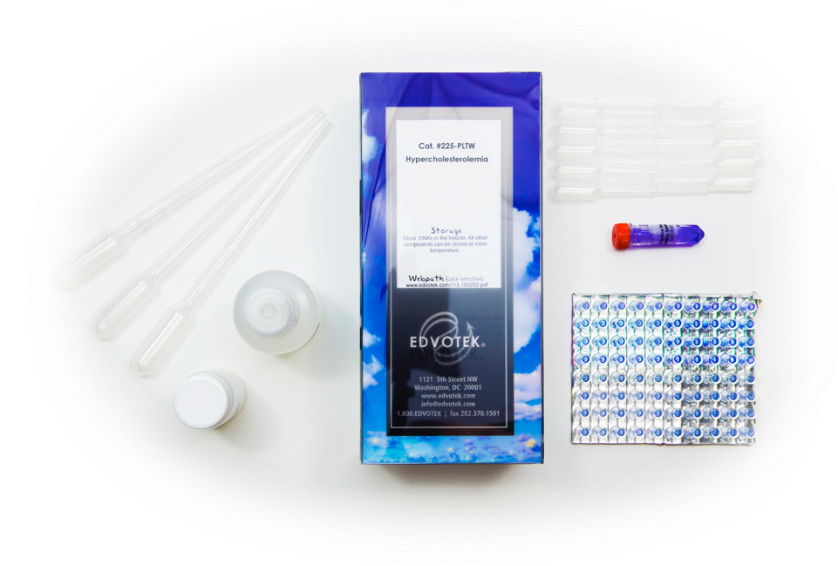
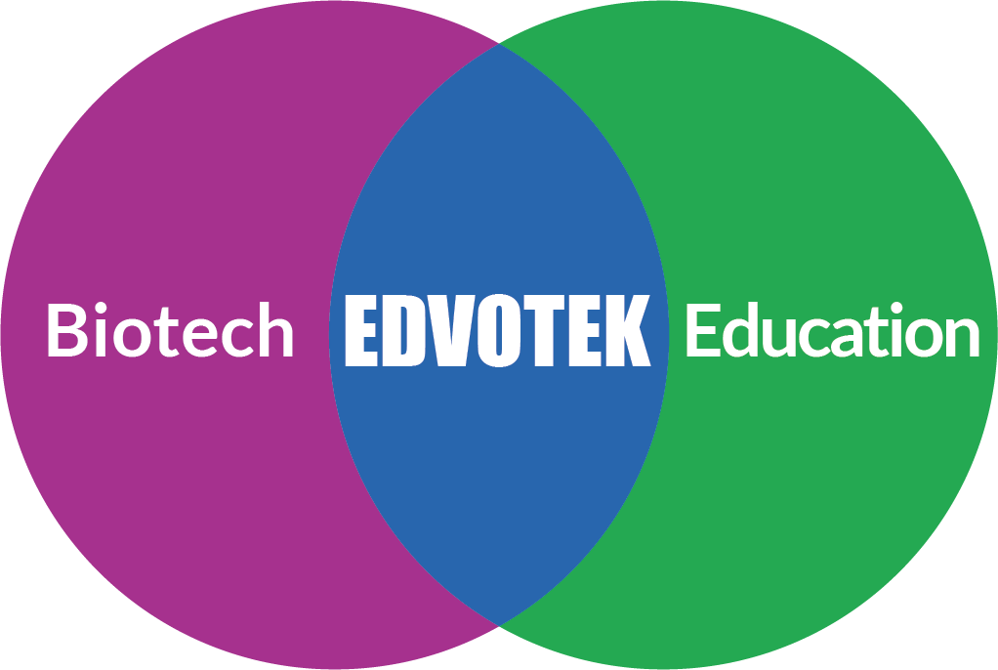
EDVOTEK The Biotechnology Education Company
Celebrating OVER 30 years
of science education!
Notes:
For those of you who are unfamiliar with Edvotek, we are the Biotechnology education company! We were founded over 30 years ago now by Dr. Jack Chirikjian, a professor of biochemistry at Georgetown University. Now, this was an exciting time in the biotechnology lab – think about it, DNA fingerprinting, the development of PCR, genetic engineering like the production of insulin in bacteria – but little of that was being translated into the classroom. And thus, Edvotek was born. Our focus is solely on the education sphere, where we work with educators all over the world to demystify science and foster the next generation of scientists through hands-on, active learning activities.

Slide 3
Today’s Experiment: Exploring Food Science with Candy
The physical characteristics of charge, size, shape, and affinity are used to separate molecules and analyze mixtures.
Analyze common foods with biotechnology
Electrophoresis: uses electricity to separate molecules
Chromatography: uses solvent to separate molecules
EdvoKit S-47
Notes:
Today we are going to focus on food science. What are food colorings, and why do we use them? How are colors created? We will be using two techniques to analyze food coloring. First, we’re using paper chromatography, which uses a paper matrix and solvents to separate molecules. We’re also using agarose gel electrophoresis to separate food dyes. This biotechnology technique is an essential to research labs – it is used in labs across the world every day. Electrophoresis uses electricity and a porous gel matrix to separate food coloring into discrete zones, or bands, based on the physical properties of the molecule. This includes charge of the molecule, its size, and its shape. While both of these techniques are very powerful, they are also easy enough to do in the classroom laboratory – or even in your home, like I’m doing today.
This demonstration will be recorded, and our slides will be available on our website. If you’d like to be notified when they’re posted, please fill the form – the link will be in the chat box. We are also offering professional development certificates to those who watch live! If you would like us to send you a certificate, please be sure to check the box. This link will only be live for one hour after the presentation, so be sure to complete it before 5 PM Eastern Standard Time.

Slide 4
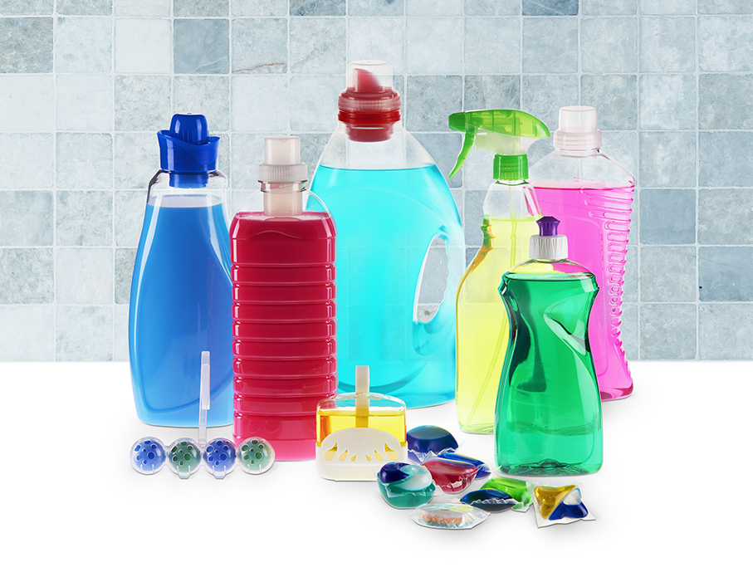
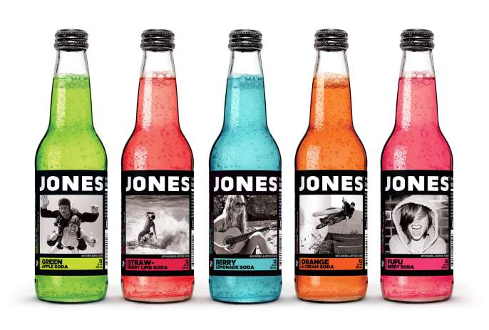
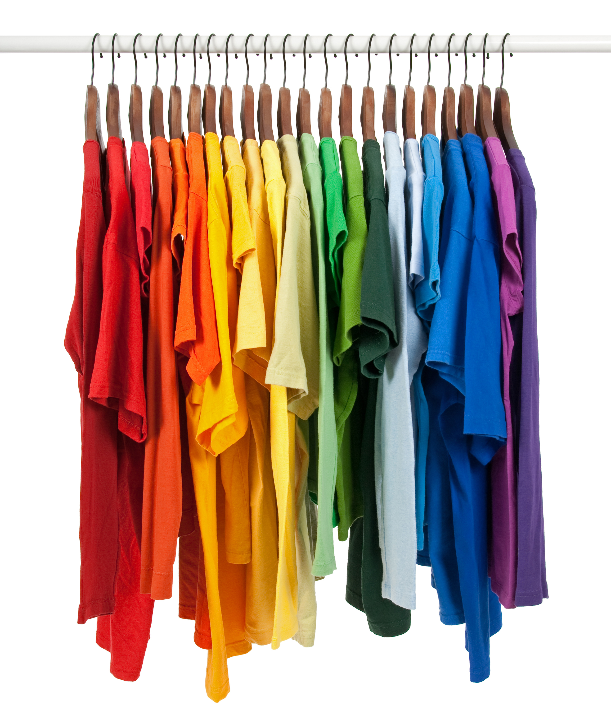
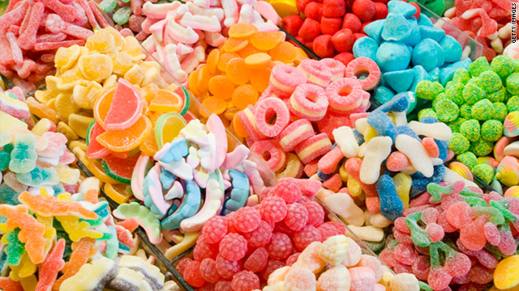
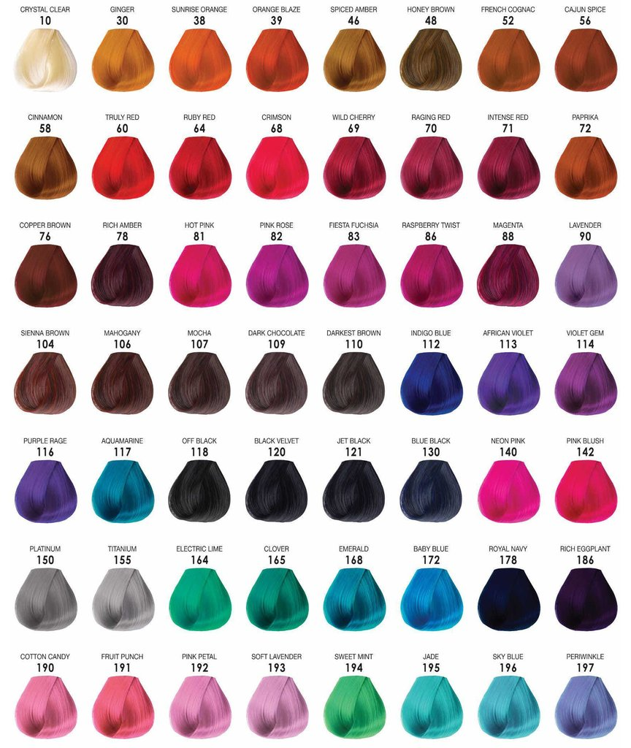
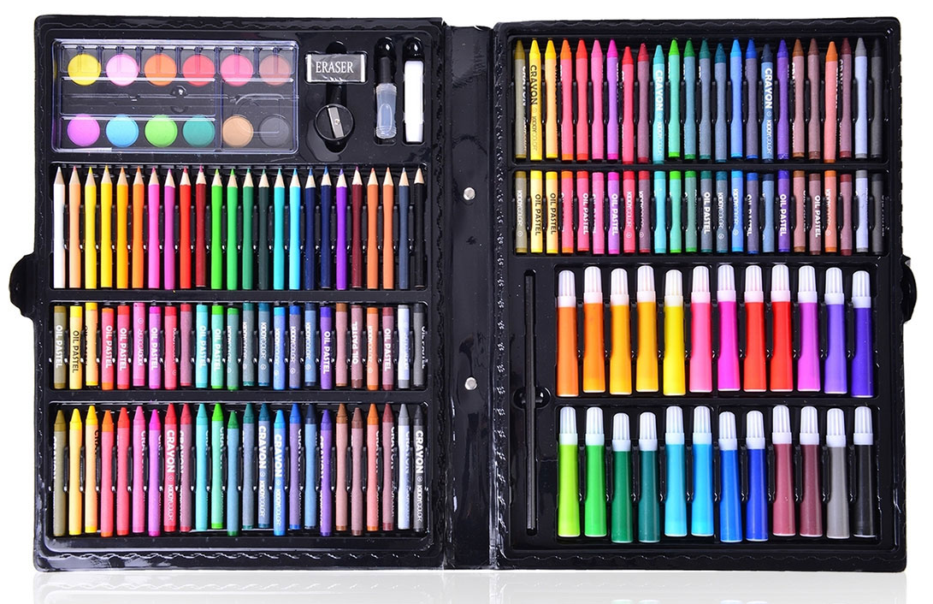
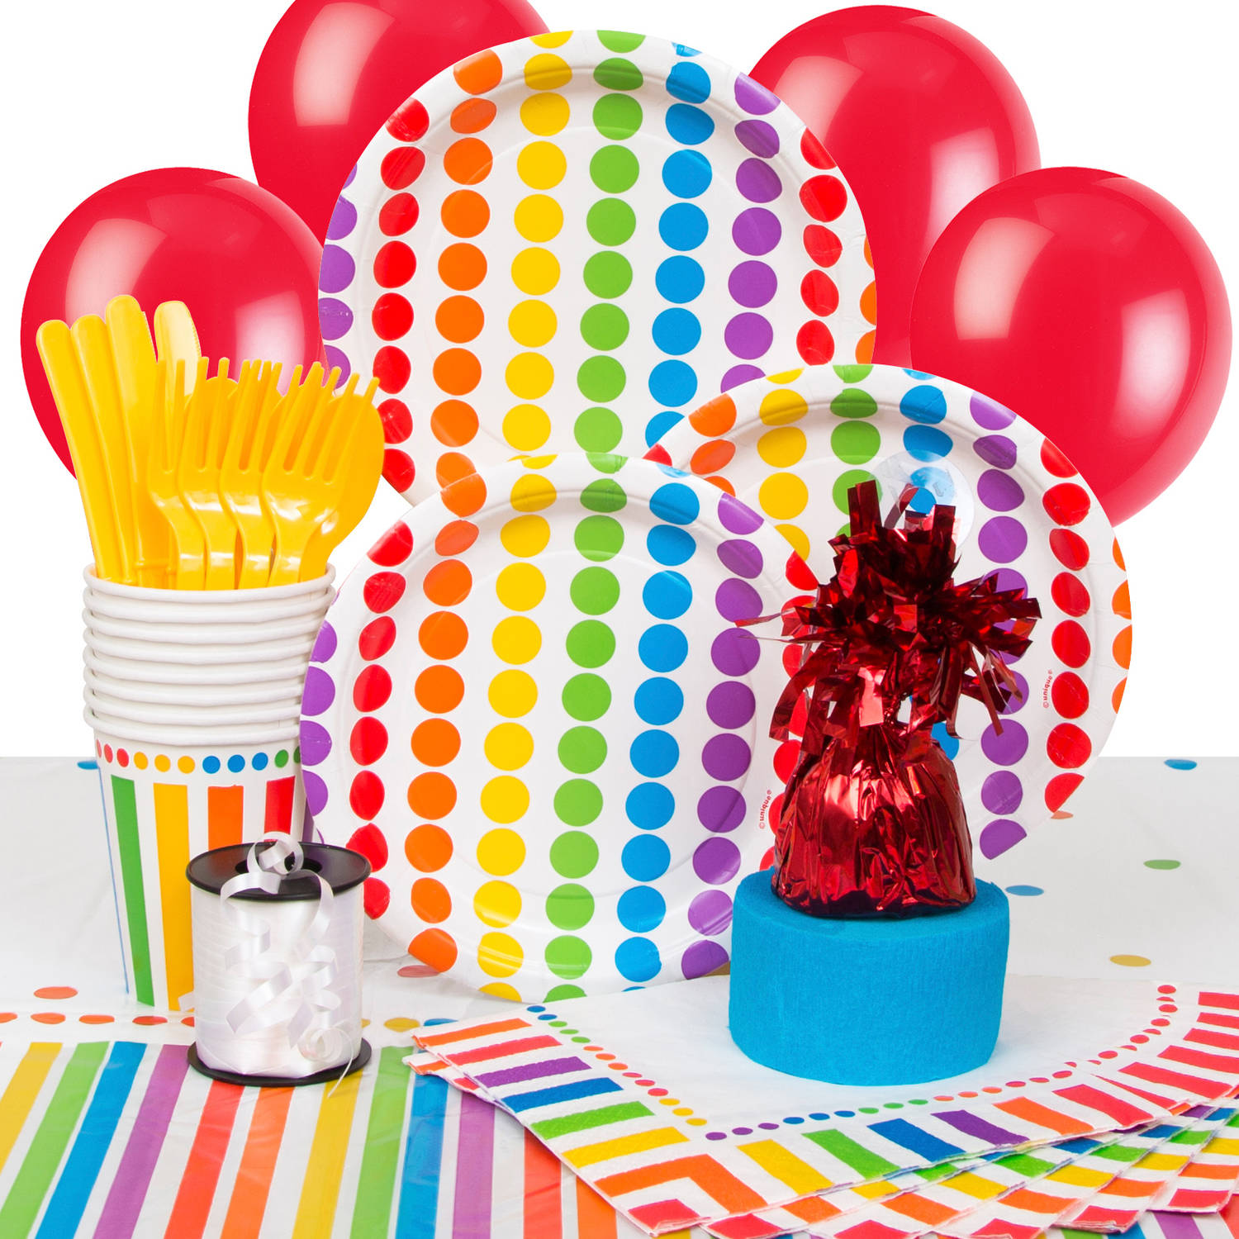
Colors in Daily Life
Notes:
So, let’s first talk about color. For those of us who can see (and who can see color… we won’t talk about color blindness here, but that’s an interesting topic to be discussed in genetics lessons!), color plays an important role in our lives. As we see here on this slide, color is everywhere: Not just our food, candy, but companies have long been introducing color additives to a variety of products, including personal care products, clothes, shoes, markers, art supplies, plates, cups, mugs, everywhere. And the vast majority of these are colored using pigments and dyes. Now, while we think of these as the same thing, they’re a little different. Pigments are usually insoluble and suspended in a liquid binder that, when hardened, allows the color to coat a material. These are present in art supplies like paints or pastels, or plastics, or in some inks. In contrast, dyes are soluble molecules that will chemically bind to a material to color it. This is like clothing dye or hair dye.
<Advance>
So, we’re going to focus on food in this live stream, specifically candy, which you likely have some at home after Halloween. The color of food has always been an integral aspect of our culture. The early Romans believed that people not only savor the flavor and the texture of food, but also “eat with their eyes.” That means the food should look as appealing as it tastes. For centuries, humans have used dyes from natural ingredients to add color to food, drink, clothing and other products. For example, saffron, paprika and other spices were used to provide food yellow appearance.
Commercially, manufacturers add colors to food to offset color loss due to product exposure to various environmental conditions, such as light, air, and moisture. Additionally, companies often add dyes to food products like beverages, jellies, pudding and condiments to make them look more attractive to consumers.

Slide 5
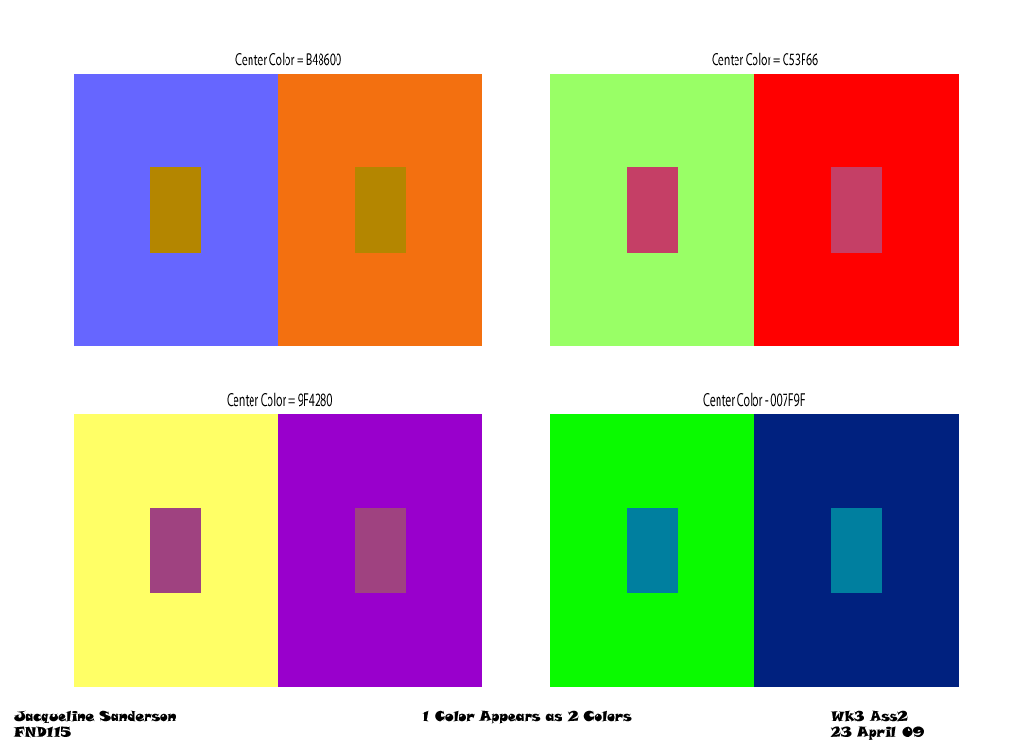
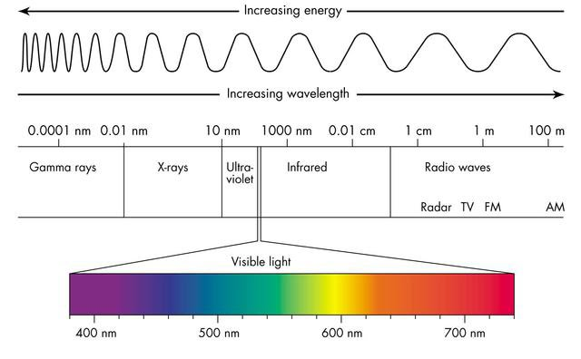
Color Theory is the art and science of color mixing
Objects appear to be colors based on the light it absorbs and reflects.
Colors are additive or subtractive
RGB = Additive color wheel
CYMK = Subtractive color wheel
Interactions between colors affect how humans perceive color
complementary colors
warm vs cool colors
Notes:
Color is determined by the wavelengths a material absorbs and those it reflects. Pigments and dyes work by absorbing specific wavelengths of light and reflecting/scattering the remaining ones. An object has the color of the wavelengths it reflects. A material that reflects all wavelengths of visible light appears white. A material that absorbs all wavelengths of visible light appears black. So, let’s think about a leaf. Leaves are green, and pigments within the leaf are absorbing light, some of which is used in the chloroplasts to make energy. That means they are absorbing all the wavelengths of light in the blue and the red area but reflecting light in the green. And that’s what we see. And this is the interplay of biology, our eyes, and physics, the properties of light and how they create color
Color Theory is the art and science of color mixing and the visual effects of specific combinations of colors. Colors are additive or subtractive. Additive colors, like the RGB system, work by adding colored light to black, like what we see with our computer monitor. It’s additive because our eyes are going to receive all the colors of light that are coming from the monitor, and that’s how we perceive color. Subtractive colors work by removing or absorbing colors from white, and this is what we see with paint. As we add colors to white paint, they will absorb the light, and we can only see what is reflected back at us.
<advance>
Colors interact with each other in different ways when mixed. Some of this is based on whether a color is warm or cool. Warm colors are colors with an undertone of red, yellow, or orange, while cool colors have a blue, green or purple undertone. And this is a spectrum, and it’s relative. We can have cool reds and warm blues based on where we find our colors on the color wheel. If we mix colors from the opposite sides of the color wheel, they cancel one another out, creating a neutral shade. But, when placed next to one another, they look good together, a bold combination. The colors pop because they’re stimulating different parts of the eye, creating a strong contrast. And these are called complementary colors, because they create the strongest contrast. You’ll often see sports teams using complementary colors, like the Lakers or the Knicks.
<advance>
Colors are also influenced by their surroundings. We have four pairs of colors here, each rectangle with a colored rectangle within. Believe it or not, the center colors in each of those pairs is the same, but your eye perceives them as different because they’re influenced by the colors around them. This is often used by artist to create drama or illusion. Furthermore, because of the qualities of pigments, paint color mixing does not always match modern digital art. Traditional pigments are not perfect, leading it interesting mixtures and colors that should “not be possible” given they may have imperfections or contamination that changes their color. And so the use of color in the laboratory is a great way to integrate STEAM into your classroom.

Slide 6
What is STEAM, anyway?
STEM integrates Science, Technology, Engineering, and Mathematics into one interdisciplinary unit.
STEAM adds the arts, through many media.
Students learn to make connections between STEAM concepts in the classroom and its practice in the real world.
Notes:
So, what is STEM? Now, STEM has been a buzzword in science education for a while now. STEM lessons are those that integrate the use Science, Technology, Engineering, and Mathematics into a interdisciplinary unit. In my mind, though, I call this good science – biotechnology doesn’t exist in a vacuum. This is an example of the process of good experimentation, where science, technology, engineering, and mathematics all depend on one another.
<advance>
STEAM takes that one step further. By integrating the arts, the A in STEAM, we can better break down complex questions, challenges, problems, or global issue into parts to discover its nature and relationships. This involves reading and researching not just ‘hard’ scientific literature, but sociology and the human implications behind a given topic. We then identify and understand content knowledge and use a line of reasoning to generate necessary solutions to real world problems, and/or answers to complex questions. By integrating the arts, we change the way we look at the data, the way we approach problems, and the way we communicate the results.
Biotech is great to teach STEAM because these experiments really integrate of science, technology, engineering, art, and math! The most important part though, when talking about these interdisciplinary experiments, is that students learn to make connections between science concepts in the classroom, its practice in the real world, and the importance of the arts as a means for communication.

Slide 7
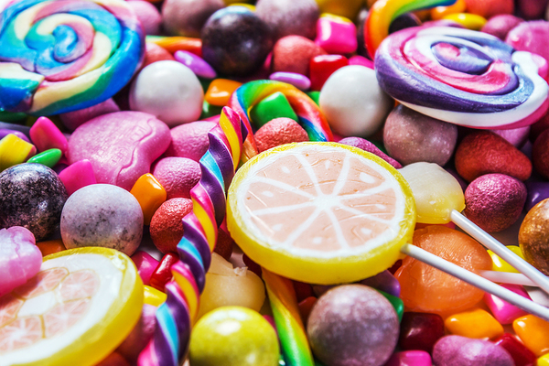
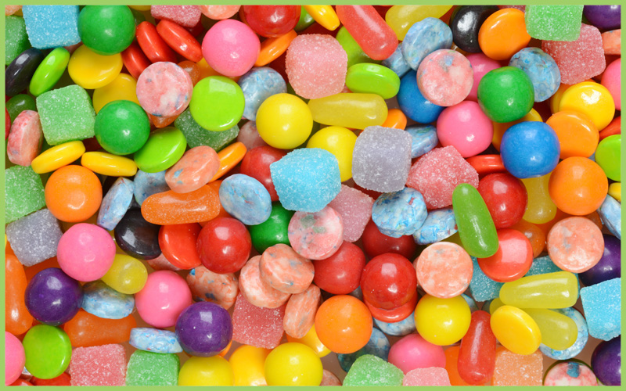
Colors in Candies
1.
2.
3.
4.
Notes:
So, to analyze the colors in our candies, we need to remove the food coloring from the candy. This is easiest in candies that are coated, where the color is on a layer outside of the candy. In this experiment, I’m using gobstoppers and M&Ms, because those are the candies have the colored outer layer. Now, I prepared a few ahead of time, but I’m going to prepare two for you now – a red m&M and a red candy. We add a small amount of the dye extraction buffer to the candy and swirl to dissolve the color. Once we get down to the white underlayer, we will remove the candy. I’m going to remove the dye from the candy and put it in one of these labeled tubes just so I can keep everything straight.

Slide 8
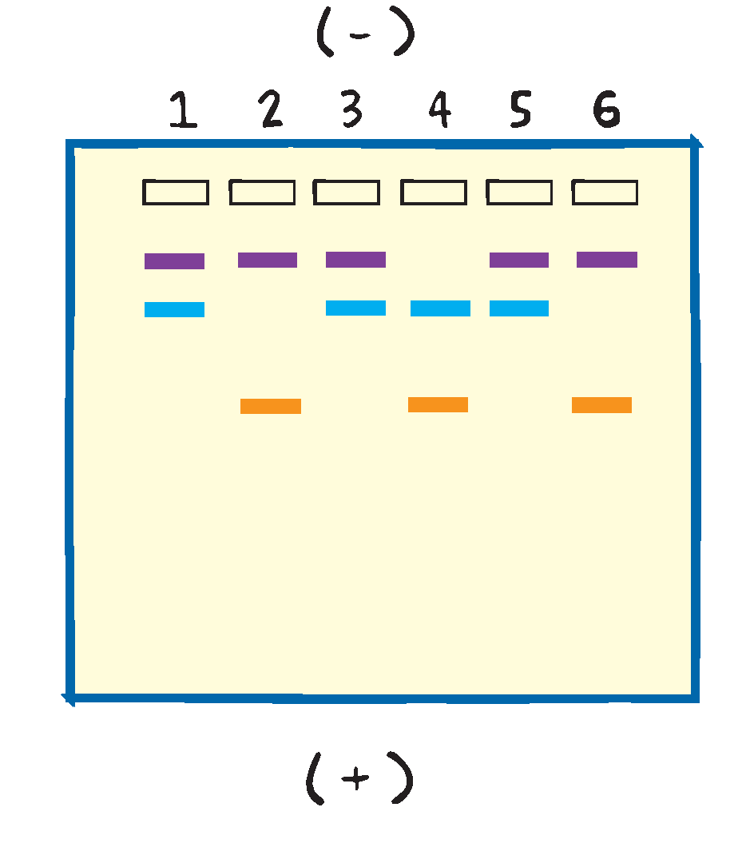
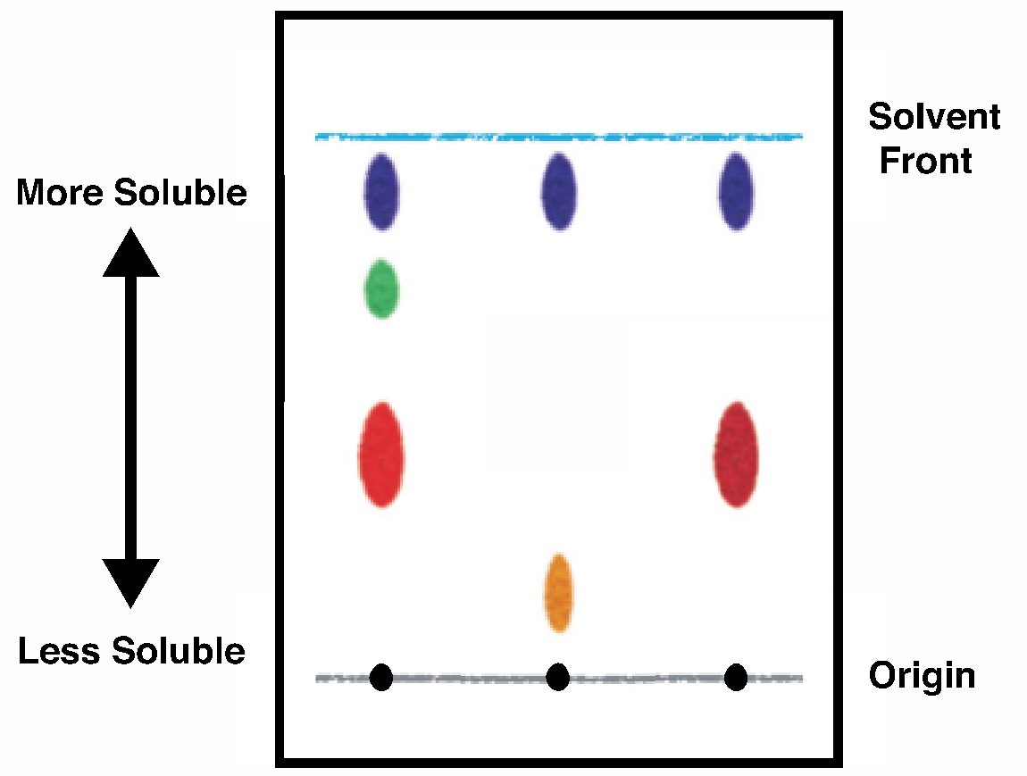
Form your hypothesis: which dyes create your color?
Thin Layer Chromatography
Gel Electrophoresis
Notes:
So, this is a fun part – which dyes create our colors? I’ll talk more about the FDA approved food dyes in upcoming slides, but we can talk about what colors we need to mix. So for instance, green is a mixture of blue and yellow, orange is yellow and red and purple is red and blue. Brown will be a mixture of multiple colors to form the neutral shade. And we have two reds here. Are they the same reds? And so, we’re going to analyze the dyes with two different techniques – paper chromatography and electrophoresis. Both are going to separate the samples into their component parts, but with differences. Paper chromatography uses a paper matrix and solvents to separate molecules. Agarose gel electrophoresis uses electricity and a porous gel matrix to separate food coloring. Both techniques separate the dyes into discrete zones, or bands, based on the physical properties of the molecule.

Slide 9
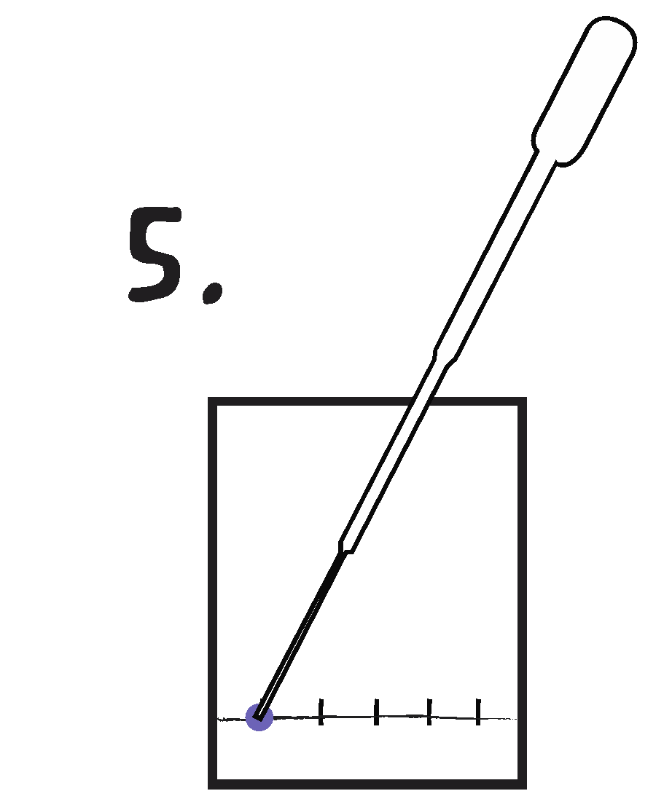
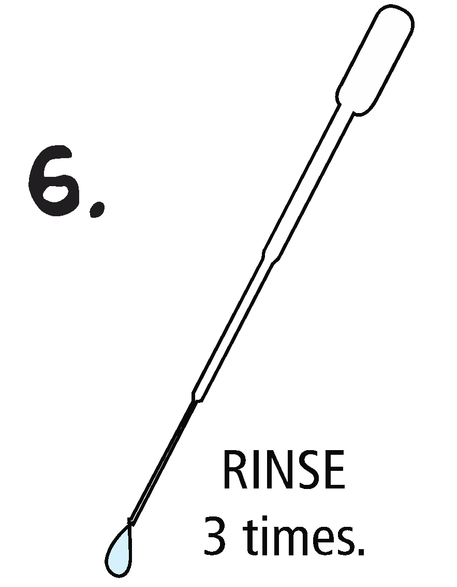
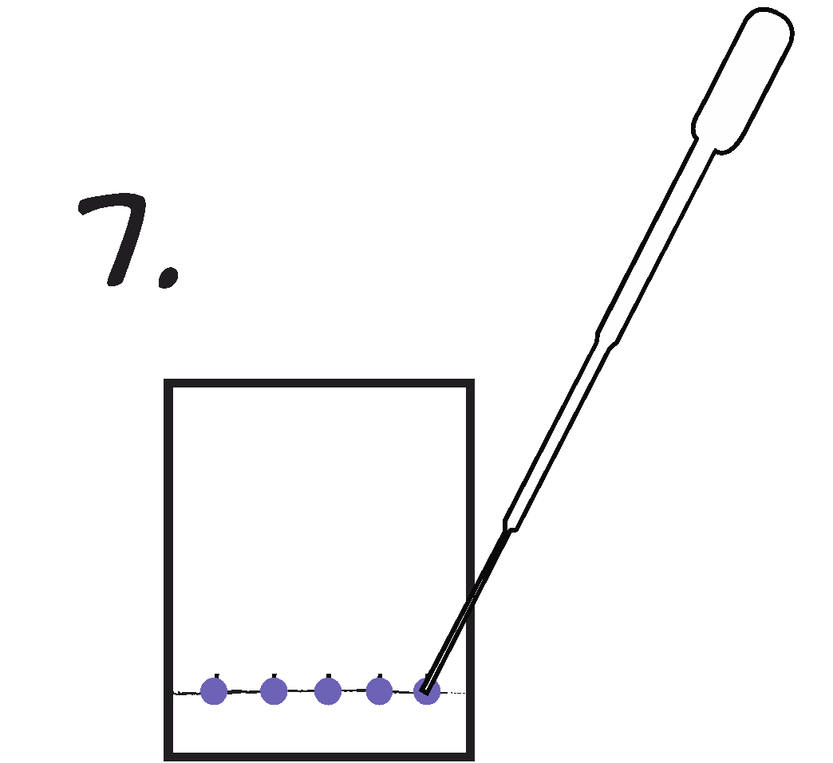
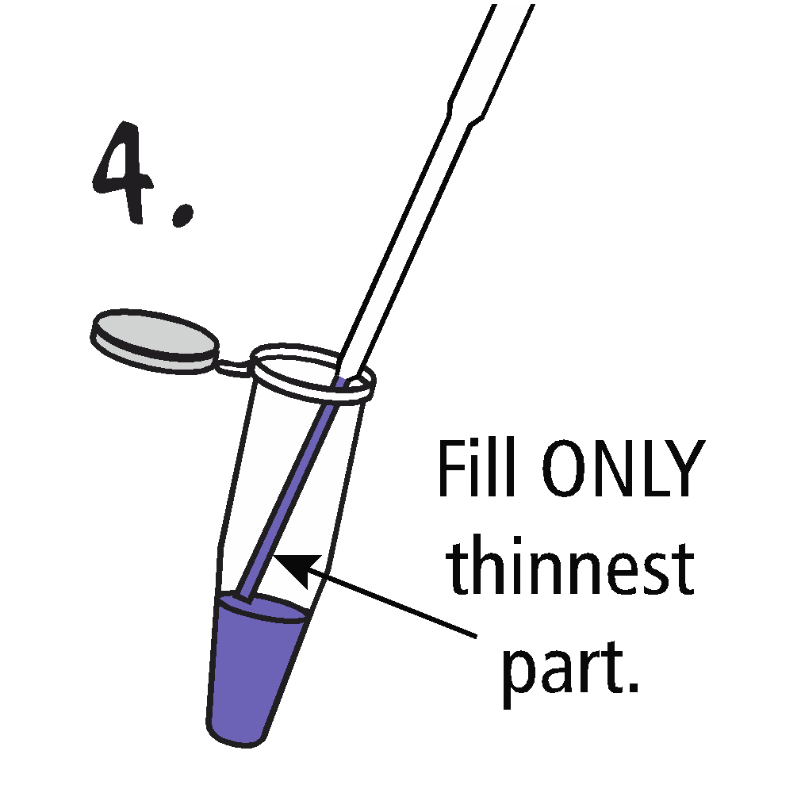
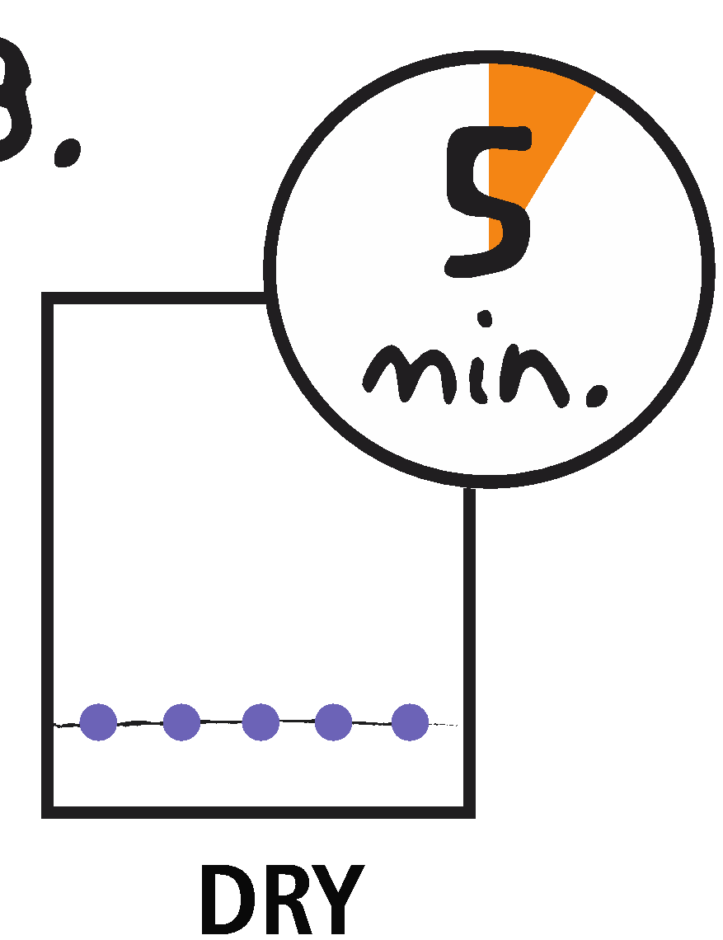
Preparing for paper chromatography
1.
2.
3.
4.
5.
Fill the thinnest part of your transfer pipet with candy color solution.
Place the end of the transfer pipet onto the paper. Squeeze and release the bulb. VERY LITTLE sample is needed.
Rinse the pipet with clean water.
Repeat with additional color samples.
Let dry ~5 minutes.
Notes:
So, we’re going to prepare our paper chromatography lesson. I’ve cut my paper substrate into a rectangle here. I’m going to use a pencil to mark baseline, ink will separate with chromatography, because it is soluble in our solvent. Fill the thinnest part of your transfer pipet with candy color solution. I actually like to squeeze lower than the bulb, gives some more control. Then place the end of the transfer pipet onto the paper. Squeeze and release the bulb. VERY LITTLE sample is needed. Rinse the pipet with clean water and repeat with additional color samples. We’re going to let this dry while I’m loading our electrophoresis gel.

Slide 10
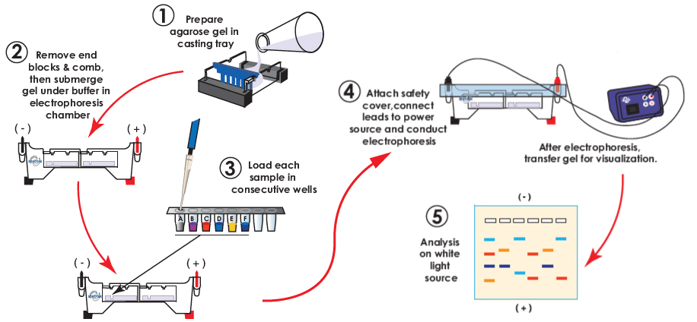
Overview of Electrophoresis
Notes:
So, if you’re interested in an in-depth electrophoresis discussion, check out one of our other live streams. For this workshop, not going to dig into specifics. Before the workshop, I cast the agarose gels – that’s like a scientific Jell-O that will physically separate our samples. The gel in the gel chamber, where it was covered with electrophoresis buffer. I’m going to load samples using an adjustable volume micropipet, and then we’ll turn on current to separate our samples.

Slide 11
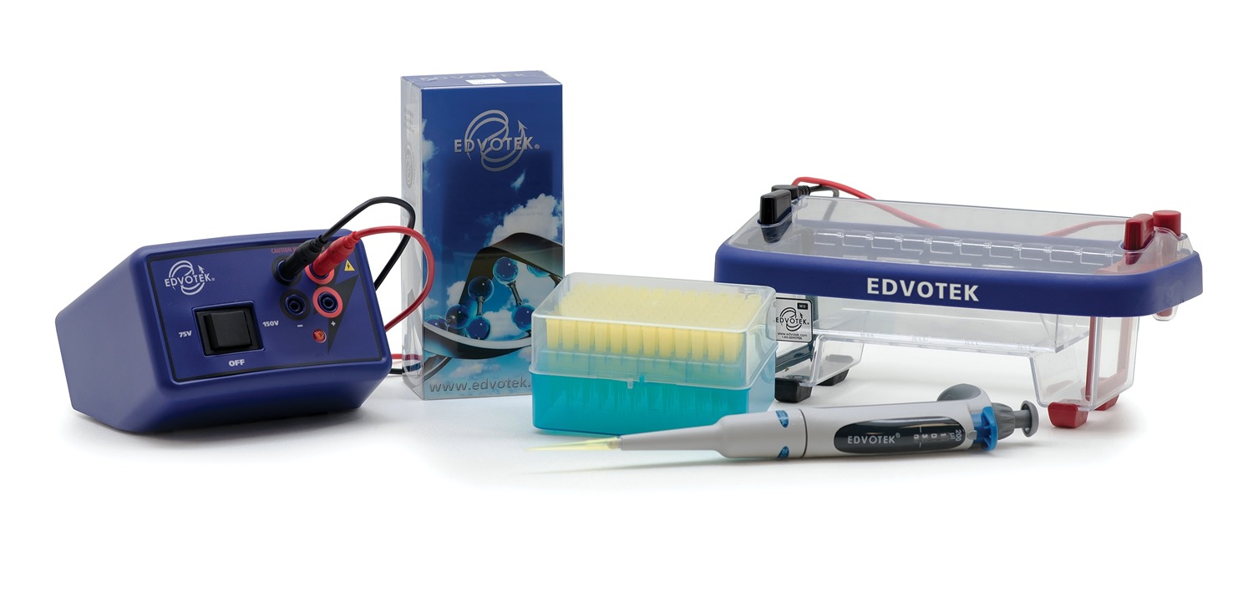
Let’s run our gel!
Variable Micropipette 20-200
Dye samples prepared with EdvoKit S-47 – Linking Food Science to Biotechnology
DuoSource 150
M12 Complete Electrophoresis Package
Notes:
Now, we change the tip between samples to prevent cross-contamination – that means unintentionally contaminating one sample with a second sample. If that happened, it could alter the results of our experiments. If something like this happens, it represents a learning moment – be sure to have your students analyze and explain what went wrong as carefully as what went right. It’s important to acknowledge that science can be messy. Even experiments that don’t work can teach us important lessons.
Our samples here are provided in QuickStrip format. These are pre-measured, single serve samples that come standard with all of Edvotek’s electrophoresis kits. Each group would get one of these strips. Personally, I think they’re pretty amazing because they save so much lab prep time. No aliquoting required! To load, use the pipet tip to puncture the foil, then push down the plunger and withdraw the sample.
You’ll notice the samples sink into the well. This is because our dyes are dissolved in a loading solution that includes buffer and glycerol. If the dye was only dissolved in buffer, it would immediately mix with the buffer in the gel chamber. So, we add glycerol to the dye solution to make it heavier, or denser, than electrophoresis buffer.
Now, let’s get the safety cover on to the electrophoresis chamber and turn on the current! We should start seeing results within a few minutes. I’ll keep the video running on the gel chamber so that you can watch as the dyes resolve into separate bands.

Slide 12
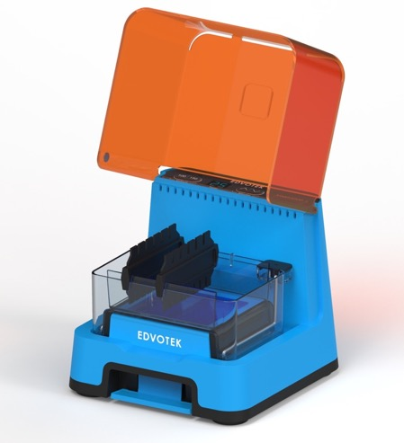
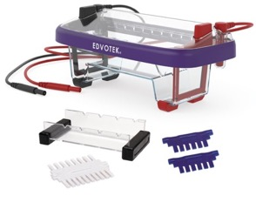
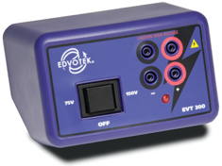
Electrophoresis solutions
Cat. #502-504 and #509
Cat. #500
Notes:
So, let’s talk a little about the equipment you need for electrophoresis. This slide features two different electrophoresis systems. The unit I’m using is the M12, which runs up to two gels at once. So, if we were in a teaching lab, this set-up could accommodate up to twelve students -- two lab groups with six students each.
Now, if you’re looking for an all in one solution, we’ve just introduced the Edvotek EDGE. This unit combines the electrophoresis chamber, the power supply, and the visualization system into one compact, easy-to-use unit. We have several other options as well, and they can all be found at www.edvotek.com

Slide 13
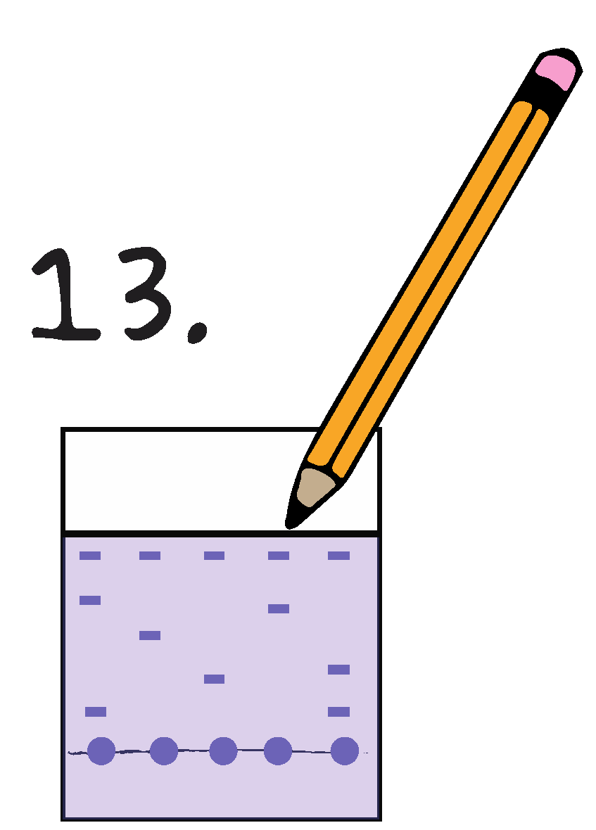
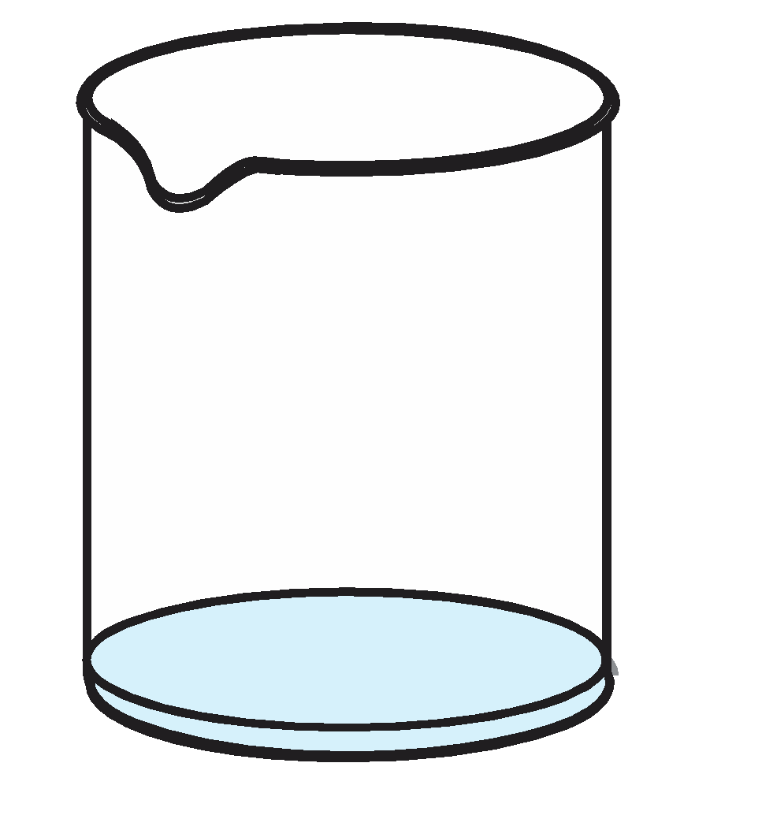
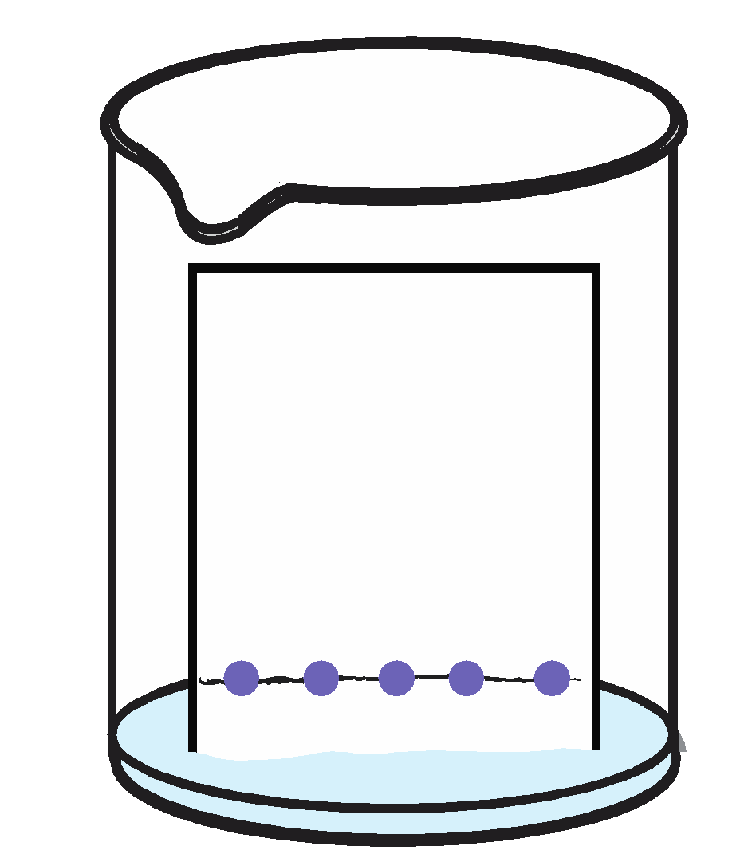
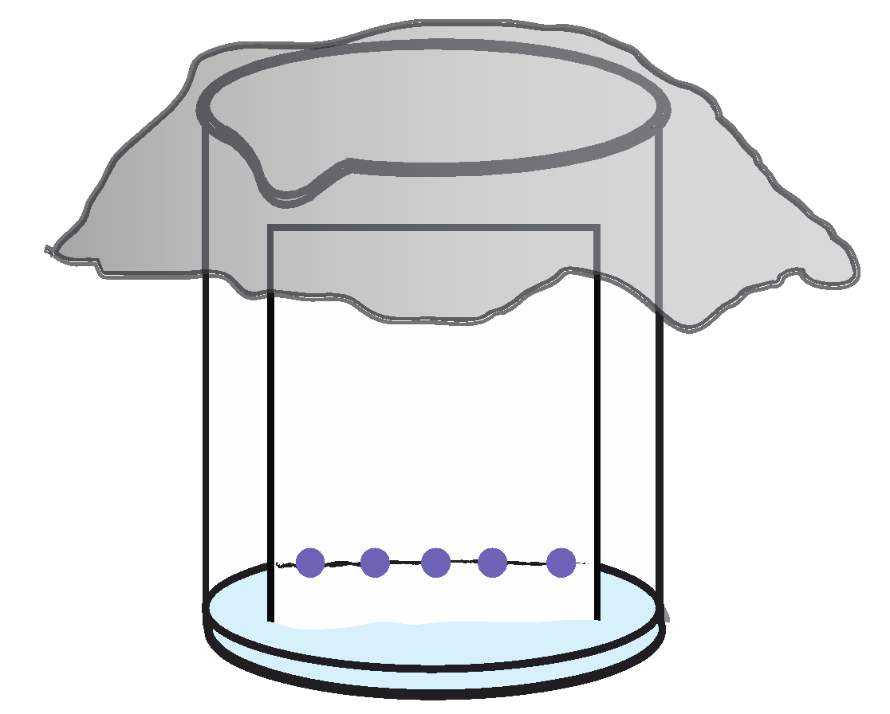
Performing paper chromatography
1.
2.
3.
4.
Pour your solvent into the cup (60% isopropyl alcohol)
Stand or tape your chromatography paper so that the bottom is touching the solvent
Allow the solvent to diffuse through the paper, moving the dye molecules
Analyze the results
Notes:
Pour your solvent into the cup (I’m just going to use 80% isopropyl alcohol, but a great inquiry based addition would be to have your students compare the differences between different isopropyl: water proportions).
Stand or tape your chromatography paper so that the bottom is touching the solvent
Allow the solvent to diffuse through the paper, moving the dye molecules
Analyze the results

Slide 14
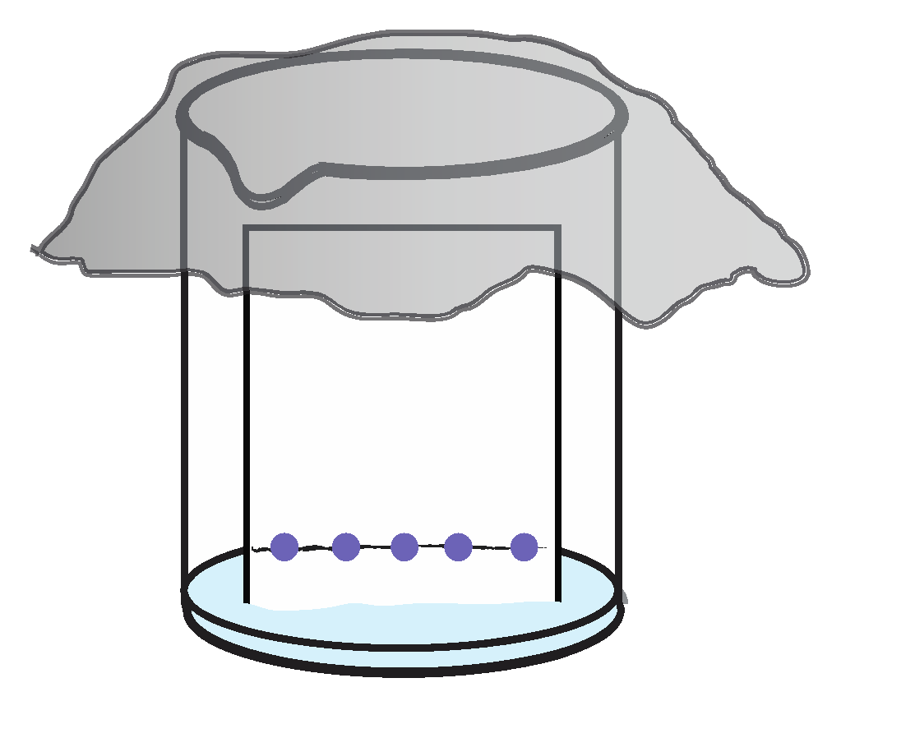
Principles of paper chromatography
Solvent travels up the chromatography paper
Soluble dyes travel up the paper with the solvent
Insoluble dyes stay at the bottom of the paper or move slowly
Retention factor is the ratio of the distance the solute traveled to the distance the solvent traveled.
Notes:
In paper chromatography, we have the stationary phase (paper) and mobile phase (alcohol). As the solvent travels up the chromatography paper, it’s going to bring the dyes up the paper. More soluble dyes travel up the paper with the solvent. Insoluble dyes stay at the bottom of the paper or move slowly. And the solubility is going to depend on the solvent. We’re using alcohol here, using plain old salt NaCl, could give us different results.
The retention factor is the ratio of the distance the solute traveled to the distance the solvent traveled. SO when the experiment is finished, we can calculate these values for the different dyes and it will help us analyze our results.

Slide 15
Food and Cosmetic Dye Regulation
The Food and Drug Administration was founded to protect and promote public health through oversight of food products, pharmaceuticals, and more
1906: The Pure Food and Drug Act
1937: Elixir Sulfanilamide disaster
1938: The United States Federal Food, Drug, and Cosmetic Act
Notes:
Okay, so let’s talk about regulation of food dyes! As the use continues to grow, concerns regarding the addition of food colors to food products have emerge. There has been discussion on whether some food dyes pose several health concerns in people, and we’ve certainly seen this in the past! For example, in the late 1800’s/early 1900’s, a green food dye containing arsenic was common, and lead was used in candy and cheese. People knew these things were not good for you, but there were no laws to prevent them from being used. So, in 1906 , The Pure Food and Drug Act was passed, and this was the first law that aimed to protect people from toxins and poisons in commercially prepared foods. This led to the creation of the Food and Drug Administration. Its main purpose was to prevent adulterated food and drug products from being sold around the country, and it allowed the government to inspect food for safety.
But just checking stuff after the fact wasn’t enough. In 1937, a medication was created using a chemical called diethylene glycol to dissolve the drug. It wasn’t known at the time that this chemical was toxic to humans. So, soon after the drug was introduced to people, more than 100 patients died. And this was because the medication was not tested before it was put on the market. IN response, the Food and Drug Administration was notified, and an extensive search was conducted to recover the distributed medicine. This led to the United States Federal Food, Drug, and Cosmetic Act (abbreviated as FFDCA, FDCA, or FD&C), is a set of laws passed by Congress in 1938 giving authority to the U.S. Food and Drug Administration (FDA) to oversee the safety of food, drugs, medical devices, and cosmetics

Slide 16
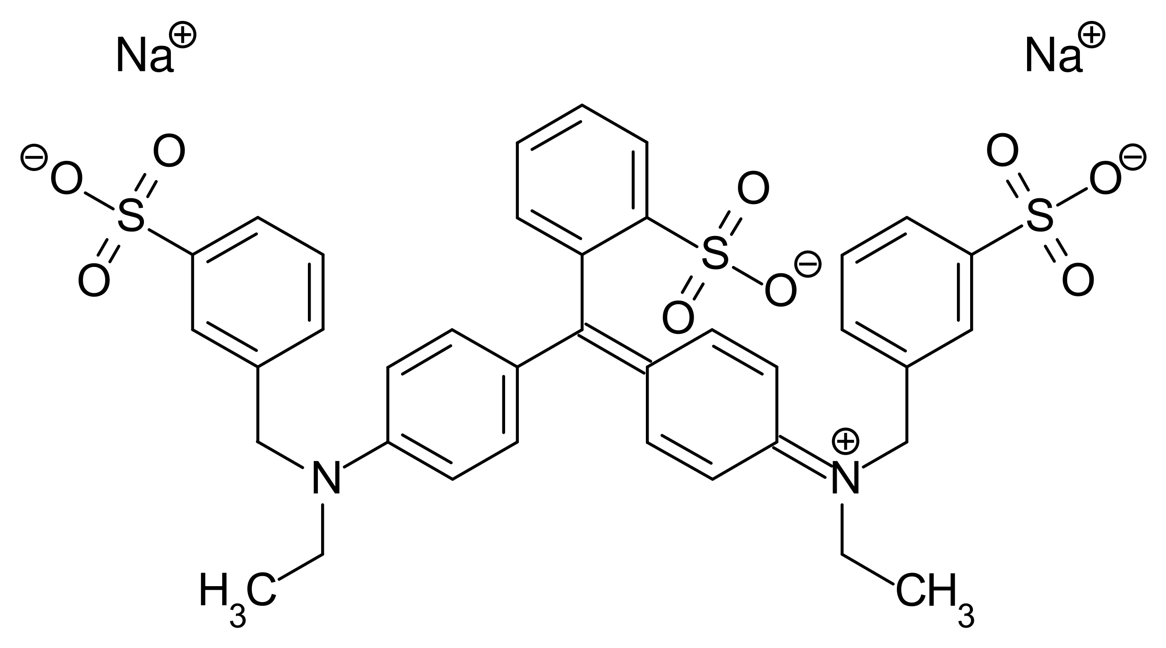
Analysis of Food Dyes
Dye molecules have an overall net charge which influences their movement through the matrix.
Tartrazine
-3 charge
Brilliant Blue
-2 charge
Notes:
So, let’s talk about the molecules we’re separating here. We’ve just loaded our gels with a mixture of different brightly-colored dyes. (If you take a look at the gel, you should be able to see them separating already.)
The structures of two commonly-used food dyes are shown here – yellow 5, or tartrazine, and blue 1, or brilliant blue. At first glance, they’re similar molecules. They’re all around the same size, and they all have aromatic rings. When we look more carefully, their chemistry is actually different – we have some different bonds, some different functional groups, all which affect the charge of the molecules. So, both of these molecules have an overall negative charge. By virtue of its side groups and bonds, tartrazine has a larger negative charge than brilliant blue, so we expect that they’ll migrate differently in our experiment.

Slide 17
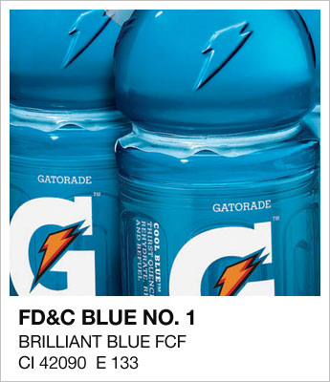
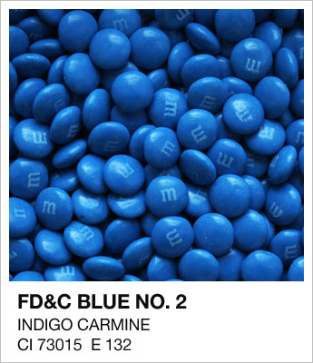
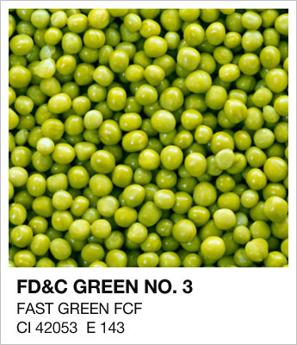
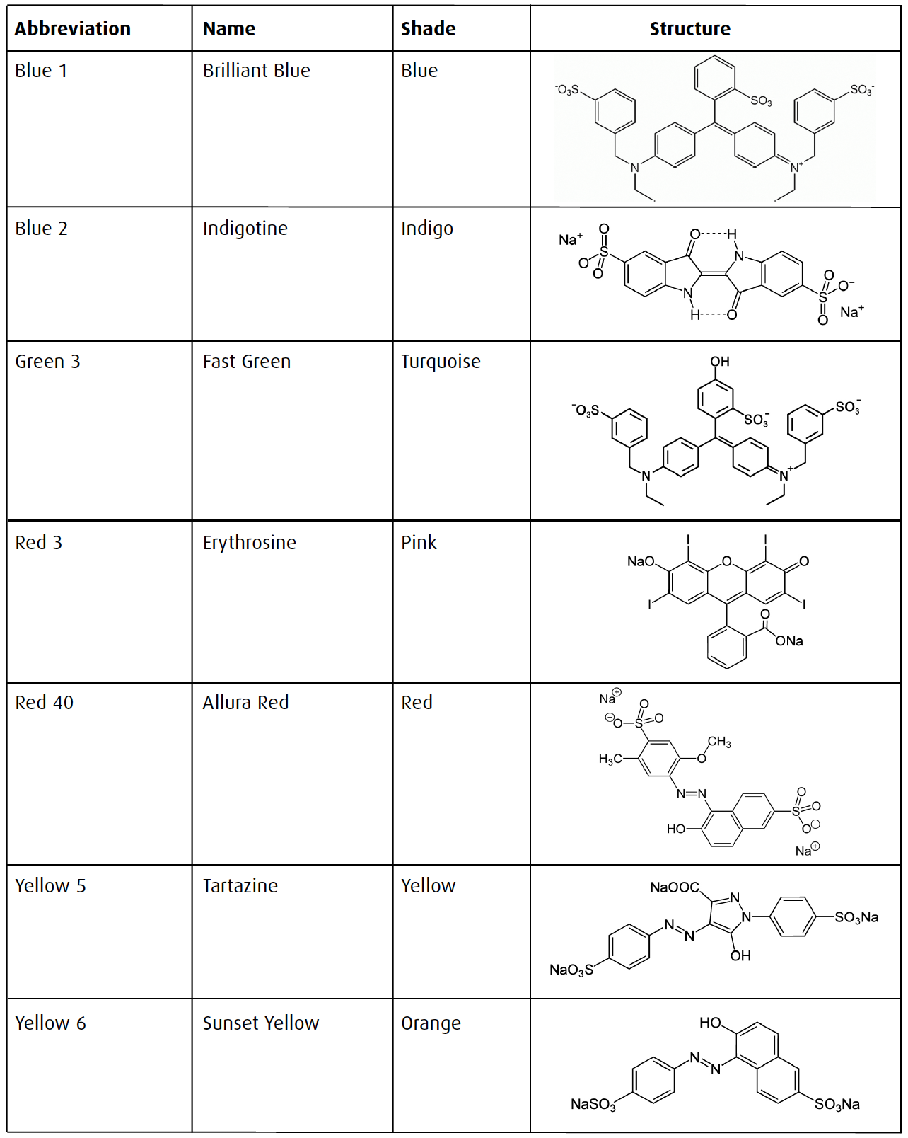
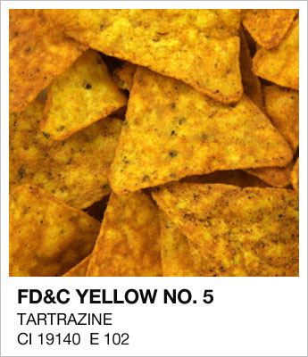
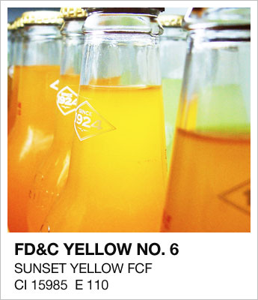
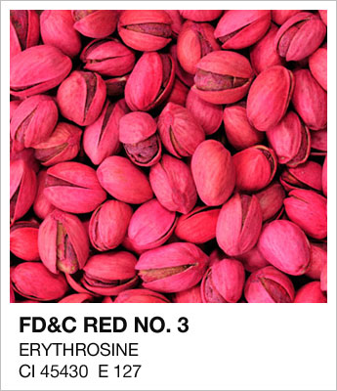
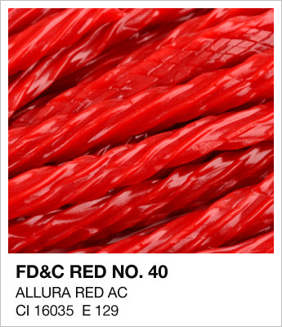
FD&C Food Colorants
Images from
idsgn.org/posts/an-edible-color-palette/
Notes:
Today, the Food and Drug Administration (FDA) is responsible for regulating color additives used in a variety of products in the United States. These are the main FD&C food colorants used today. Color additives allowed for use in foods are classified as “certifiable” or “exempt from certification”. Certifiable color additives are man made which are tested by the manufacturers and the FDA to assures the quality and safety of the color additives. This table illustrates the seven commonly used food dyes in the United States. Of these dyes, Blue 1 and Red 40 are the most common blue and red dyes while Green 3 and Blue 2 are rarely used. Food containing these approved dyes are called “For Coloring Food” and have the abbreviation “FCF” preceding their names.
And so I loved these pictures because they showed foods that were colored with different food dyes. There are two more which are used in very limited but I didn’t put them here.

Slide 18
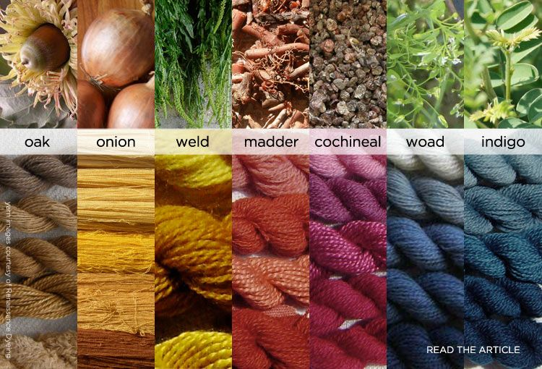
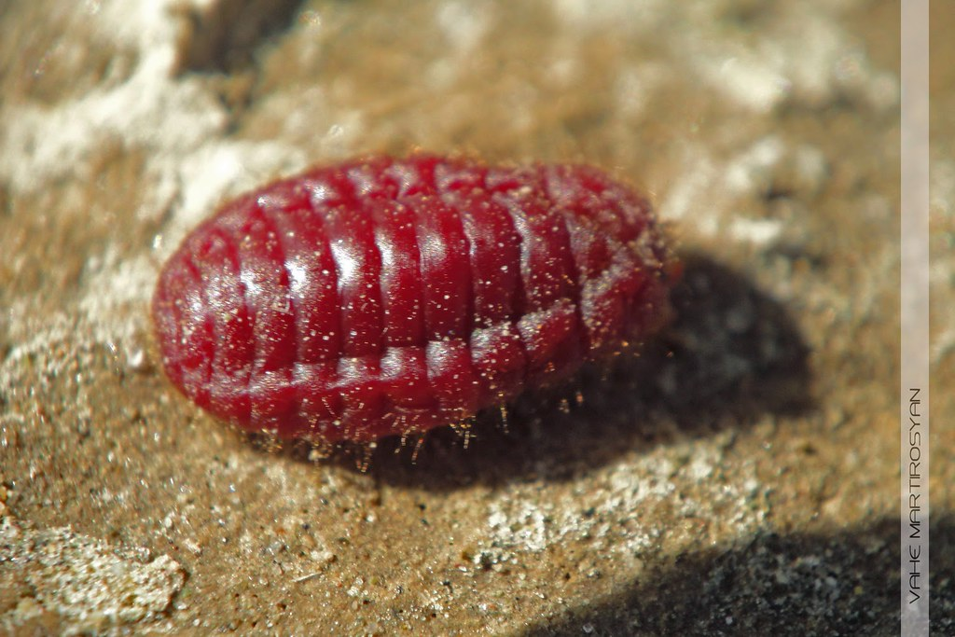
Natural Dyes
Notes:
IN foods, color additives that are “exempt from certification” are those that derived from natural sources such as vegetables, fruits, and minerals. And you’ll find that some foods and clothing are colored with natural colorants. So here are a few common colorants that are used in different contexts. You’ll definitely have heard of indigo, which is the plant-based dye that is commonly used to dye denim. One controversial one that is used in food and for clothing is cochineal. This pigment was in the news a few years ago because of its use in a Starbucks drink.
<Advance>
So, this pigment is extracted from bugs. And it’s completely safe, and has been used in food and makeup for centuries. It’s 100% natural, and don’t forget that some parts of the world do eat insects as a regular part of their diet. They’re a great source of protein. However, it is not common in the US to eat insects, so this caused a bit of controversy.

Slide 19
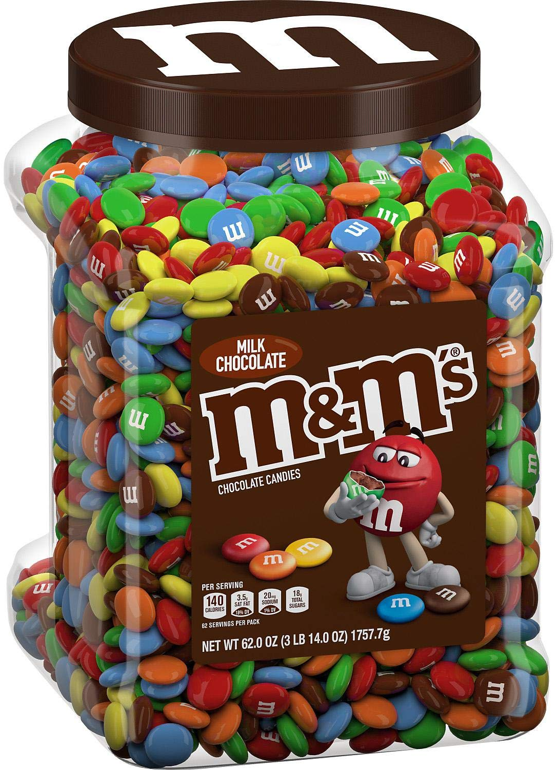
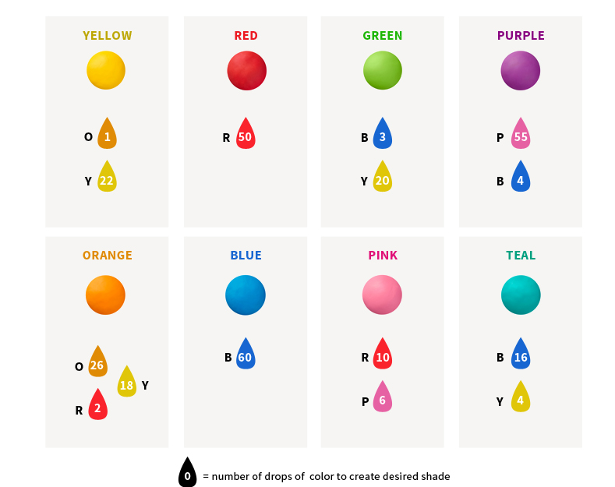
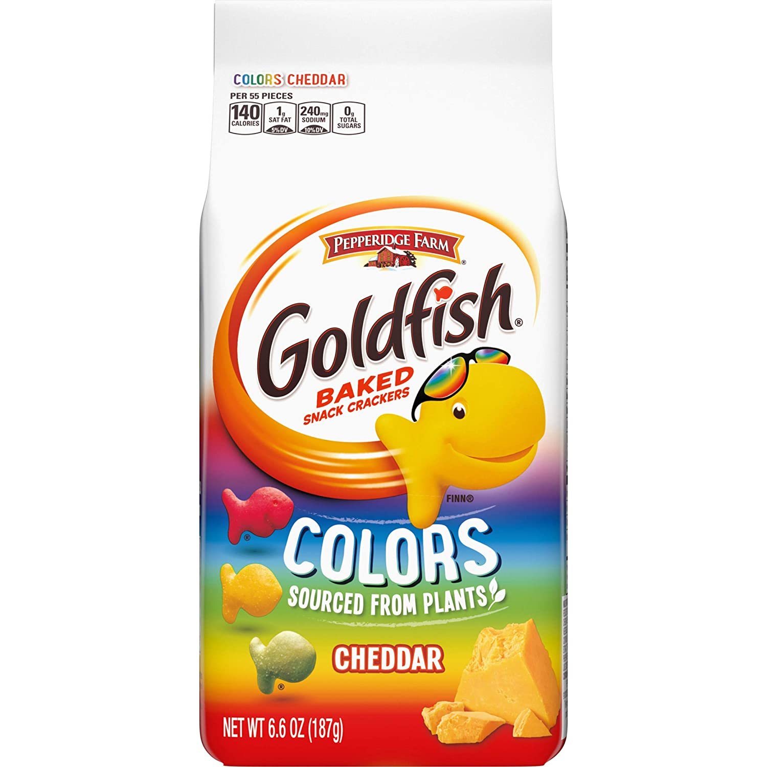
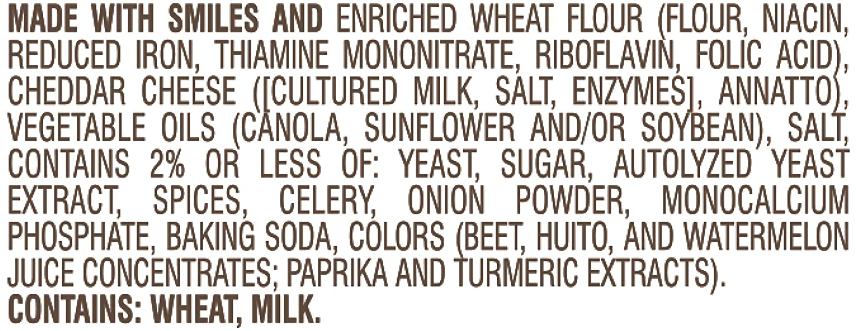
Understanding Food Labels
Certain colors are created using a combination of dyes.
Notes:
For our experiment today, the mixing of colors is a key concept for students to understand. Red plus yellow equals orange, etc. With food coloring, we’re working with a limited palette of colors based on our approved food dyes. Here’s a color mixing chart from a food coloring company. And you can see here that each color has it’s own recipe. Not only do the food dyes matter, but a different proportion of each food dye is used in different recipes to create a different color. See green versus teal. In addition to our chemical analysis, we can use a little detective work too to figure out what food dyes
<advance>
Companies are required to list food dyes in their list of ingredients. We can see that from these labels which product uses natural colors, and which uses artificial colors. We can also see which food dyes are used. And so, between our knowledge of color mixing, and reading the labels, we can start to make educated guesses as to which colors are used in each candy.

Slide 20
Summary of Electrophoresis
Notes:
Now, we’re almost finished with our electrophoresis experiment. Let’s just recap what we’ve done so far. Before the workshop, I cast the agarose gels – remember, that’s our scientific Jell-O. We placed the gel into the gel chamber, where it was covered with electrophoresis buffer. We loaded our samples using an adjustable volume micropipet, then placed the safety lid on the gel chamber, and turned on the power supply to generate the current necessary for electrophoresis. While we were discussing the history of electrophoresis, the dye samples were separating into different bands based on their charge. Now, we’re ready to take a look at our results.

Slide 21
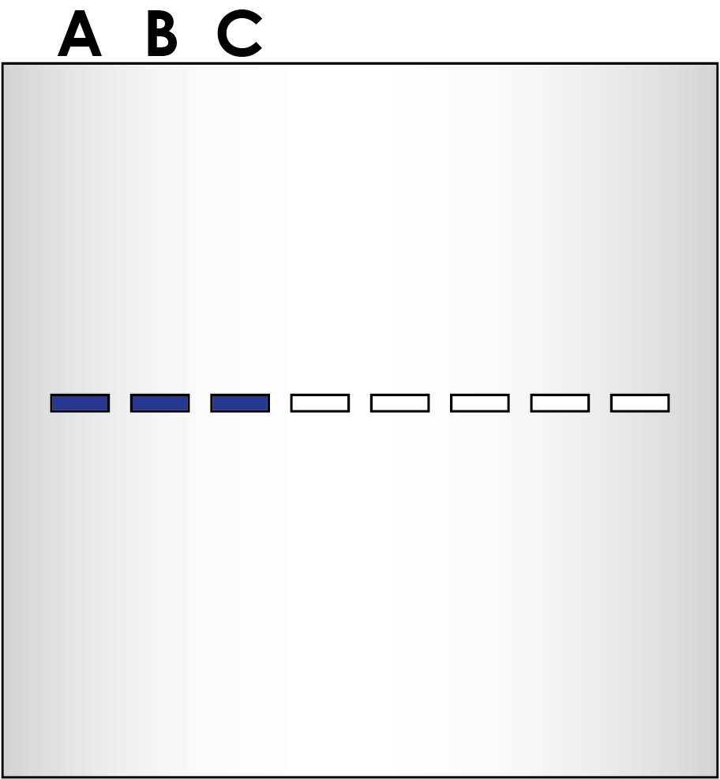
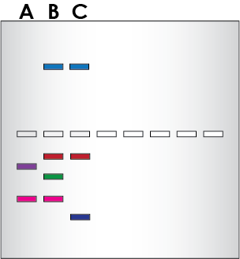
Electrophoresis Separates Dyes By Charge
The samples are loaded into the gel, and an electrical current is passed through the gel.
The current drives the negatively charged dyes through the gel towards the positive electrode, and positively charged dyes to the negative electrode.
The dyes separate into distinct zones based on their charge.
Notes:
So, what does this mean when we add the samples to the wells and apply current?
(Animation)
The dye molecules have an overall net charge which influences their movement through the gel. Because molecules with different charges travel at different speeds, they become separated and form discrete “bands” within the gel.
(Animation)
Some of the dyes are negatively charged (like DNA) and will move through the gel towards the positive electrode. Dyes with greater net charges will be more strongly drawn to the electrodes. So, for example, we looked at two charged dyes before. Because of its larger charge, the Yellow dye moves through the gel more quickly.
In contrast, some dyes are positively charged dyes. Instead of travelling to the positive electrode, it is going to travel to the negative electrode. If you’re used to seeing DNA gels, this is going to look like the sample is running in reverse! But, it’s doing exactly what it should be doing based on its chemical properties.

Slide 22
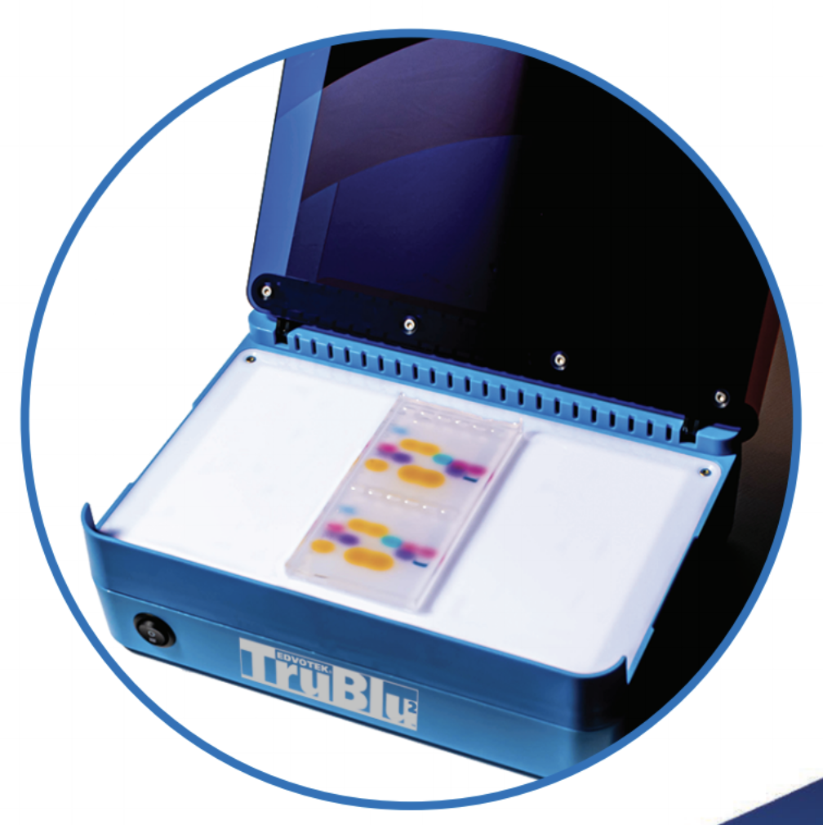
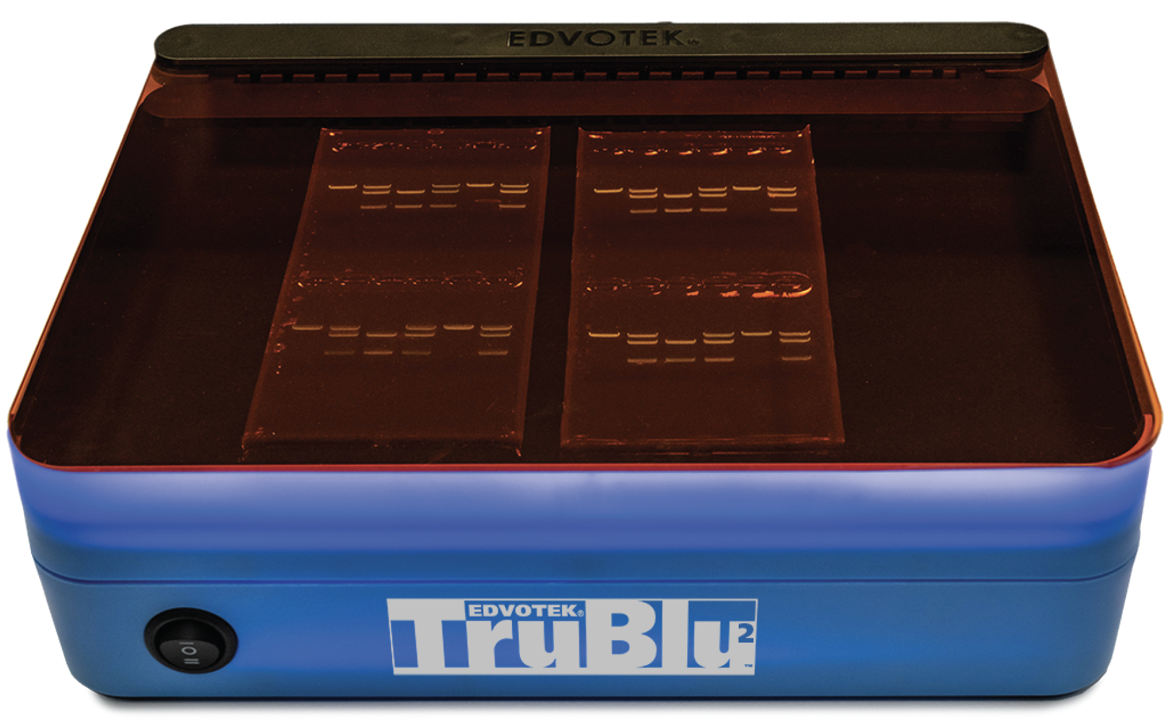
TruBlu2™ Bluelight Transilluminator
• Option for blue or white light •
• Optimized for SYBR® Safe stained gels •
• Large viewing area • No harmful UV •
Notes:
Both blue and white light feature, perfect for visualizing dye electrophoresis.

Slide 23
Results and Conclusions
Was your hypothesis about your color of candy correct?
What color combinations do you see?
Are there different speeds/migration rates for different solvents?
Compare electrophoresis to chromatography.
Notes:
So, let’s review the results. Gel electrophoresis rapidly separates molecules based on their physical and chemical properties. Let me take the lid off of the chamber so that you can see the gel a little more clearly. What you’ll see is that each dye traveled through the gel in a different way. Same with paper chromatography.
Discuss what you see. Was your hypothesis about your color of candy correct? What color combinations do you see? Are there different speeds/migration rates for different solvents? Compare electrophoresis to chromatography.

Slide 24
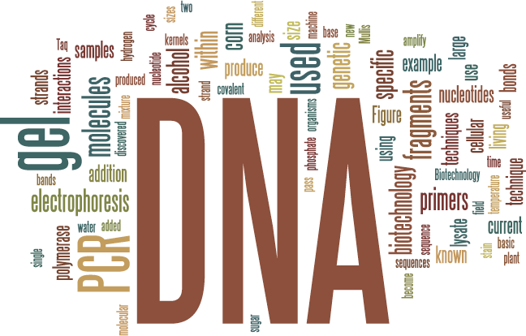
Today’s Experiment: Exploring Food Science with Candy
The science of color affects our everyday lives.
Color is based on the wavelength of light reflected off an object.
Basic colors can be mixed to create different colors with unique qualities (hue, value, intensity).
Chromatography and electrophoresis separates molecules into discrete bands based their physical and chemical properties.
Notes:
So, we’ve come to the end of the experiment! We’ve covered a lot of information over the course of this experiment. The use of color in food is truly a great way to integrate STEAM into your classroom, which is basically STEM plus art. The most important part though, when talking about these interdisciplinary experiments, is that students learn to make connections between science concepts in the classroom, its practice in the real world, and the importance of the arts as a means for communication.
We talked about the properties of light that create different colors, and how, through mixing colors, we create new colors and influence surrounding colors.
We learned how agarose gel electrophoresis and paper chromatography can rapidly separate molecules into discrete bands based on their physical properties. While fairly simple – I mean, we just did this experiment together in my basement, it is very powerful when it comes to rapidly separating different molecules from one another.

Slide 25
EDVOTEK, Inc. The Biotechnology Education Company
To Request this Presentation:
https://forms.gle/mLseKB9Nhb5wJhw26
For Orders & Technical Service:
Phone: 1-800-EDVOTEK (1-800-338-6538)
Web site: www.edvotek.com
Email: info@edvotek.com
Check out our YouTube Channel:
www.youtube.com/EdvotekInc
Follow our social media for offers & updates:
www.facebook.com/edvotek
https://twitter.com/edvotek
https://www.instagram.com/edvotek
Notes:
We will be posting the presentation and the slides in the next few days to our website www.edvotek.com. If you’d like us to email you when they are available, please fill out this form and we will contact you in a few days. Now, I am happy to answer a few questions.
Thanks so much for your time. If you need us, please reach out to us at info at edvotek dot com, or try one of our social media channels. We look forward to helping you get biotechnology into your classroom! Stay safe, everyone.

